Slide 1
WARSON RESIDENTIAL BUILDING, DUBAI
FAÇADE CONCEPT DESIGN – FAÇADE + BALCONY + PODIUM
May 2023

Slide 2
OPTION - CURVED BALCONY
GRID

Slide 3
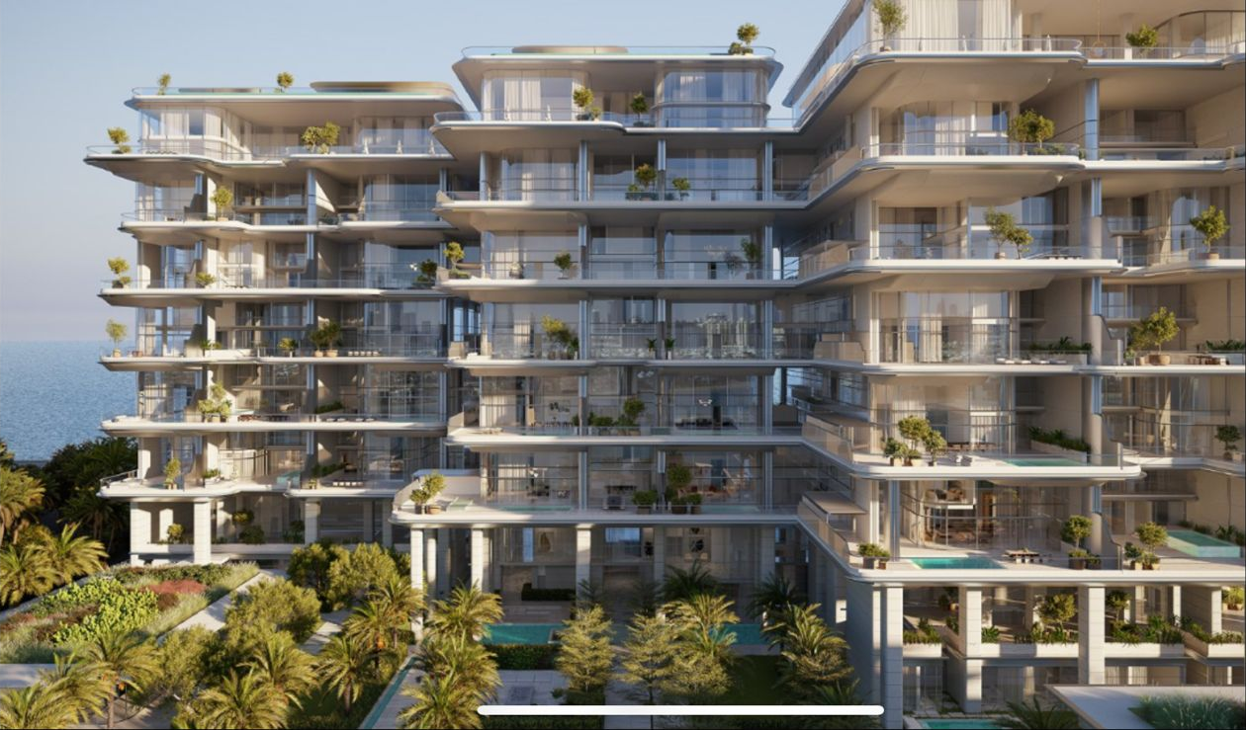
CLIENT REFERENCES
| REFERENCES |

Slide 4
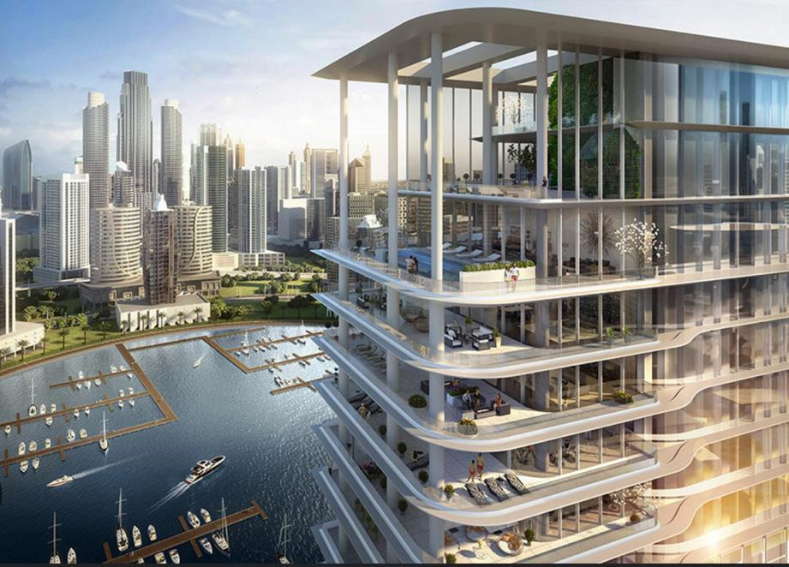
CLIENT REFERENCES
| REFERENCES |

Slide 5
CLIENT REFERENCES
| REFERENCES |

Slide 6
CLIENT REFERENCES
| REFERENCES |

Slide 7
CLIENT REFERENCES
| REFERENCES |

Slide 8
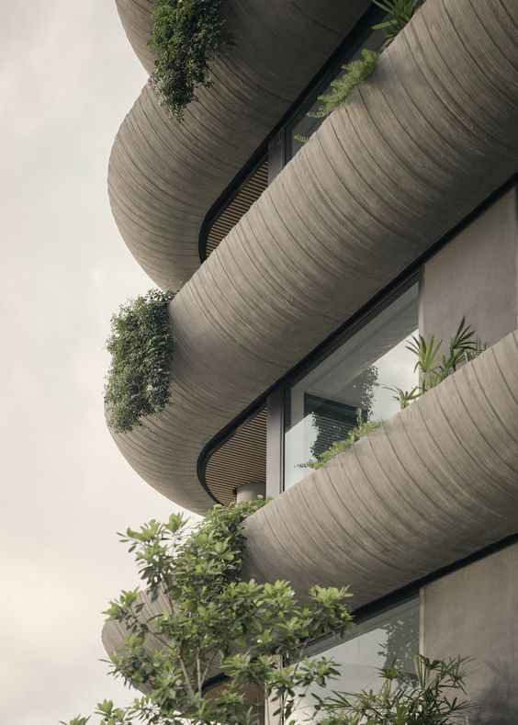
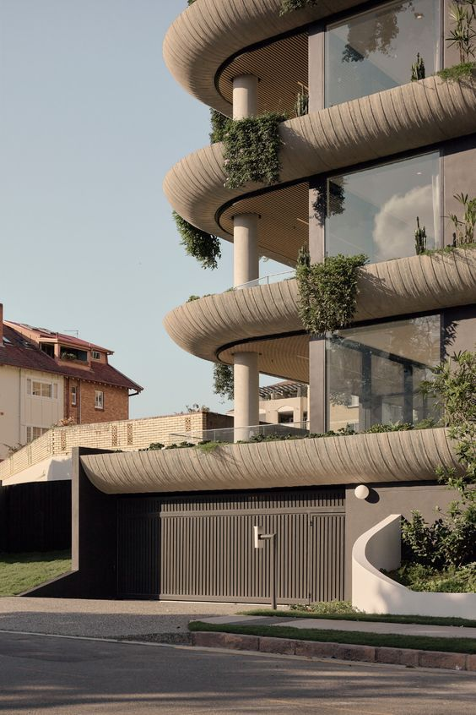
CLIENT REFERENCES
| REFERENCES |

Slide 9
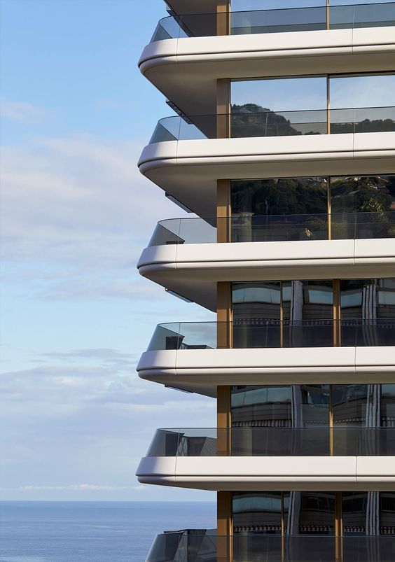
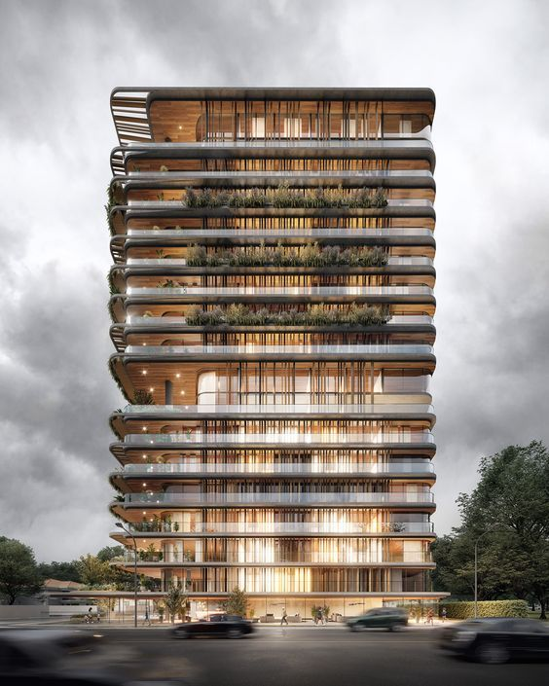
CLIENT REFERENCES
| REFERENCES |

Slide 10
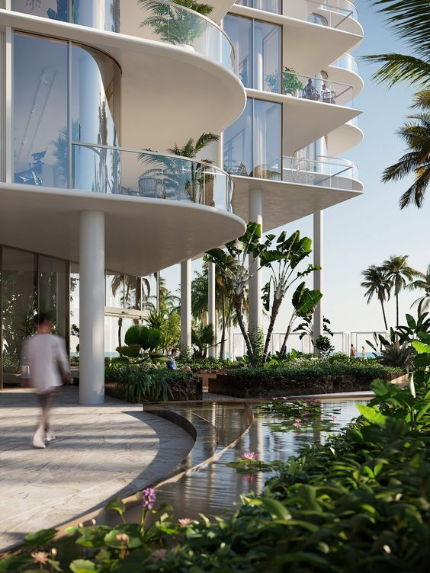
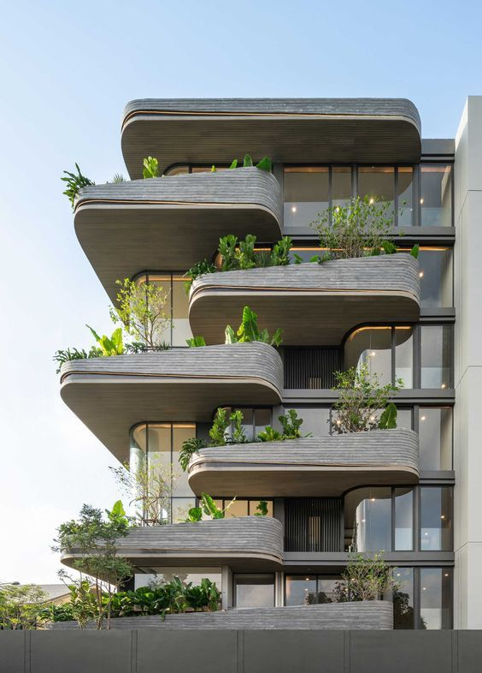
CLIENT REFERENCES
| REFERENCES |

Slide 11
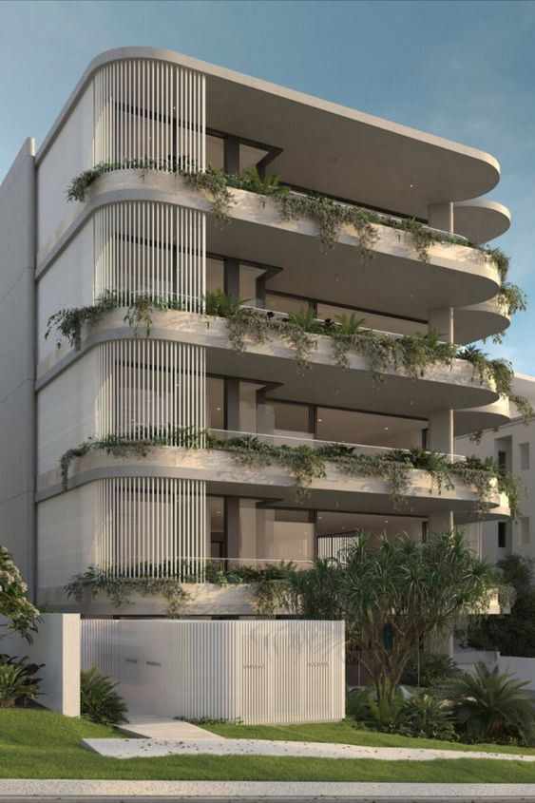
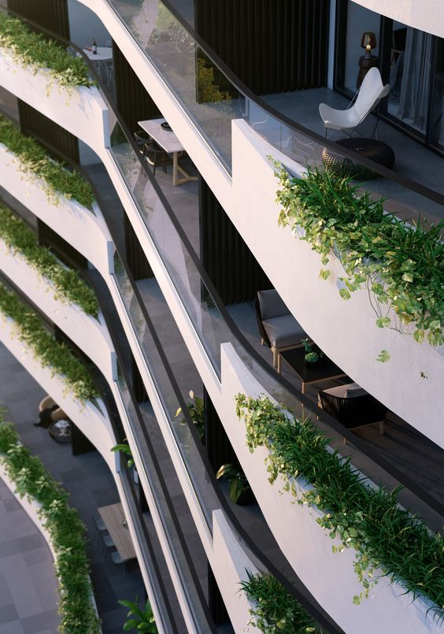
CLIENT REFERENCES
| REFERENCES |

Slide 12
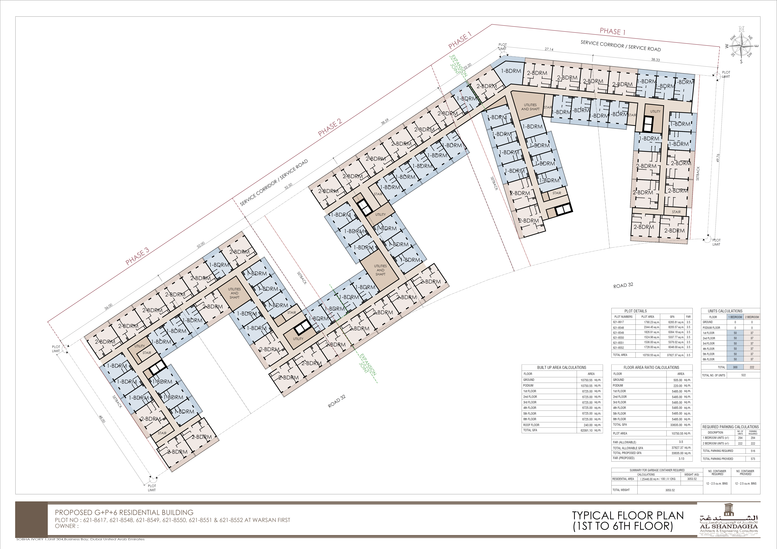
SELECTED FAÇADE FOR DESIGN PROPOSAL

Slide 13
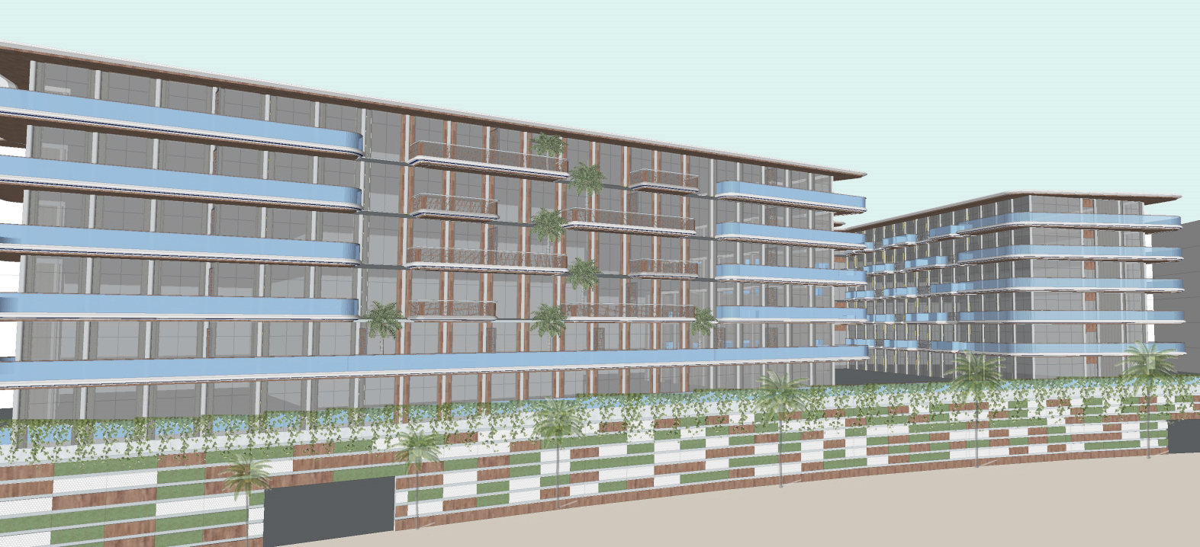
| ELEVATION WITH CURVED BALCONY

Slide 14
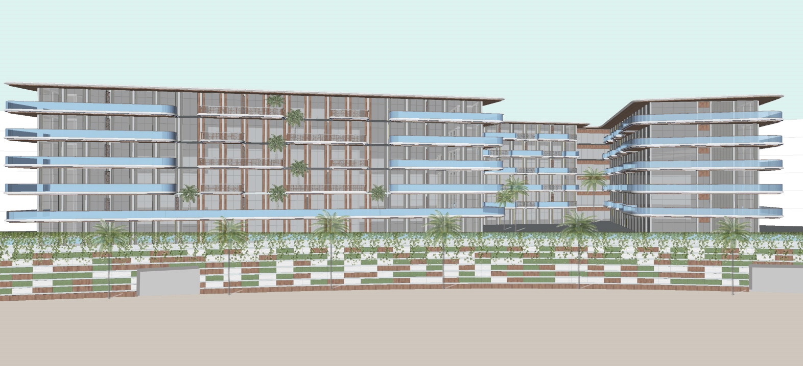
| ELEVATION WITH CURVED BALCONY

Slide 15
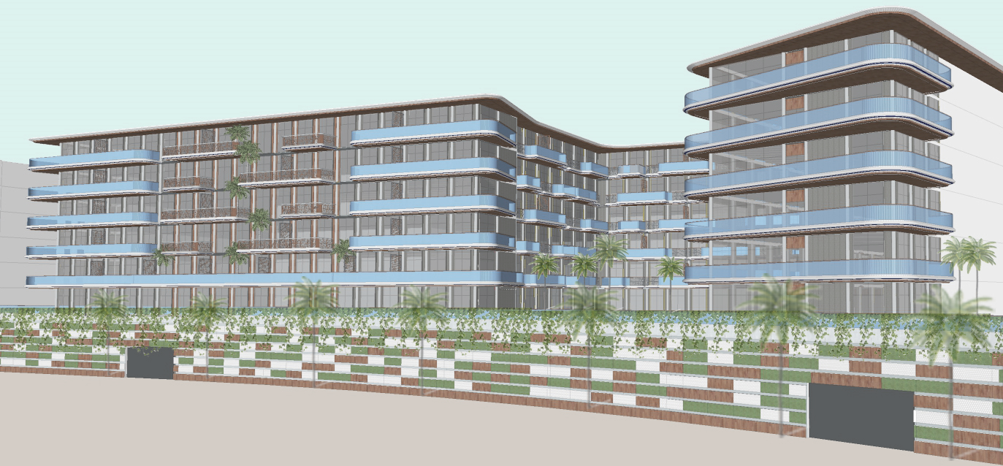
| ELEVATION WITH CURVED BALCONY

Slide 16
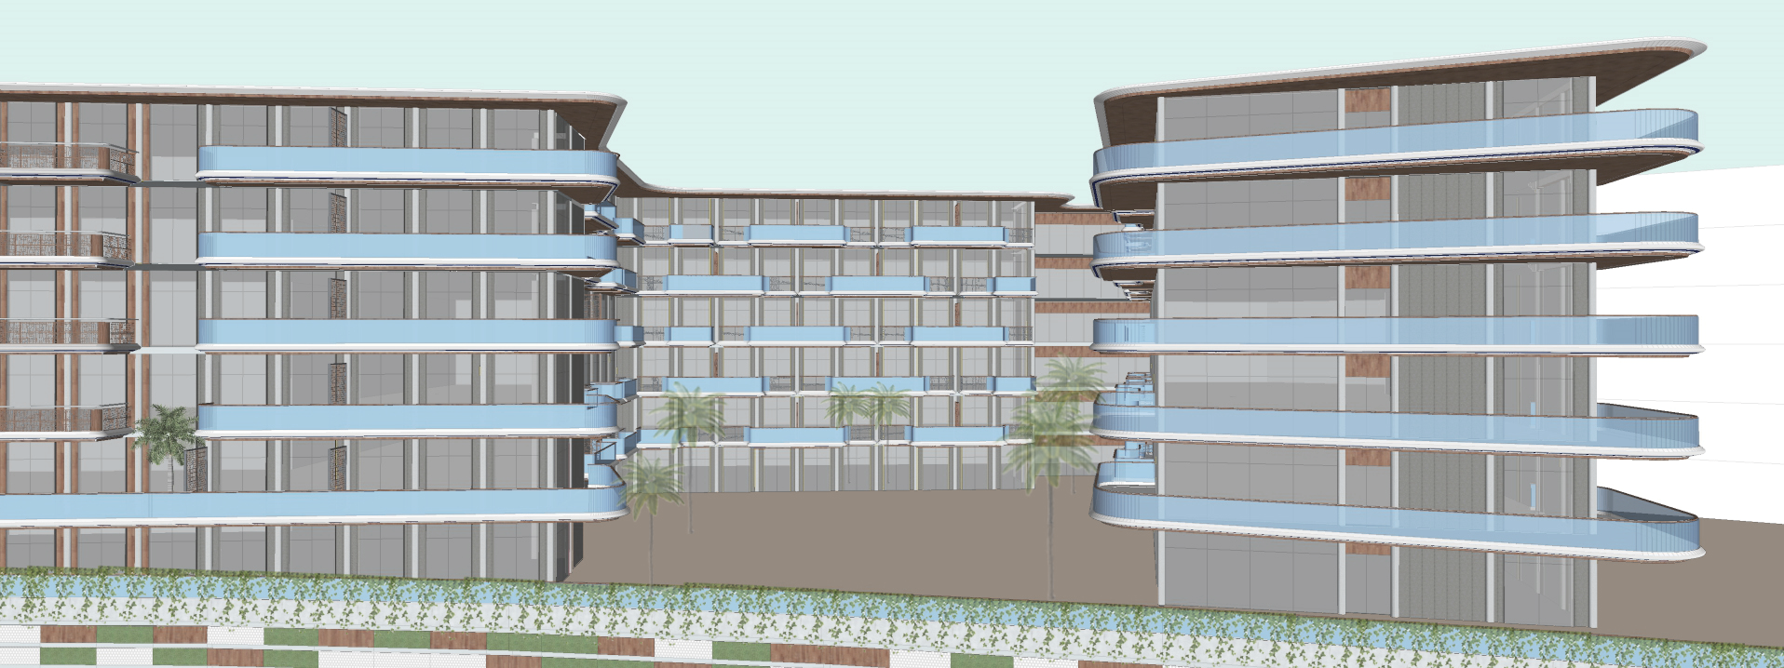
| ELEVATION WITH CURVED BALCONY

Slide 17
ELEVATIONAL COMPONENTS
GRID

Slide 18
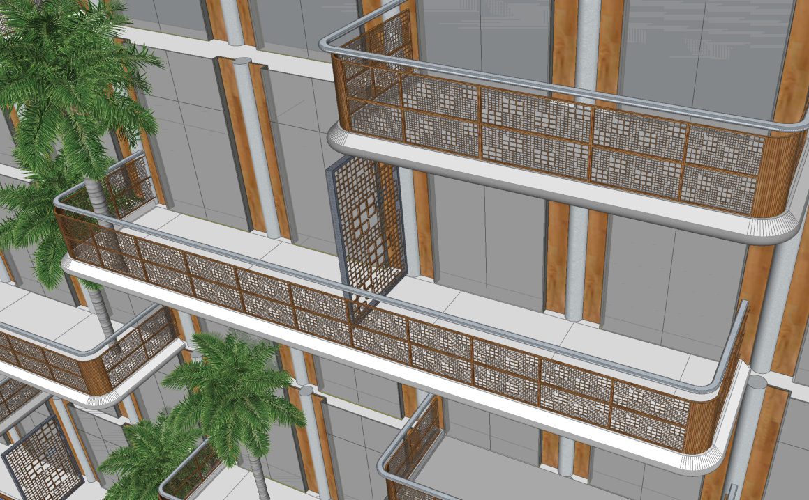
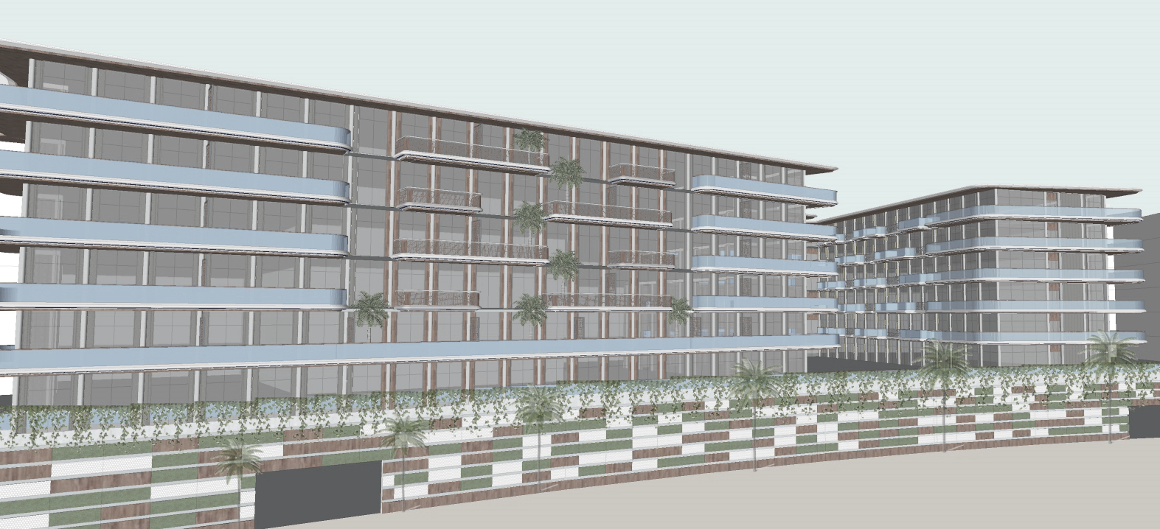
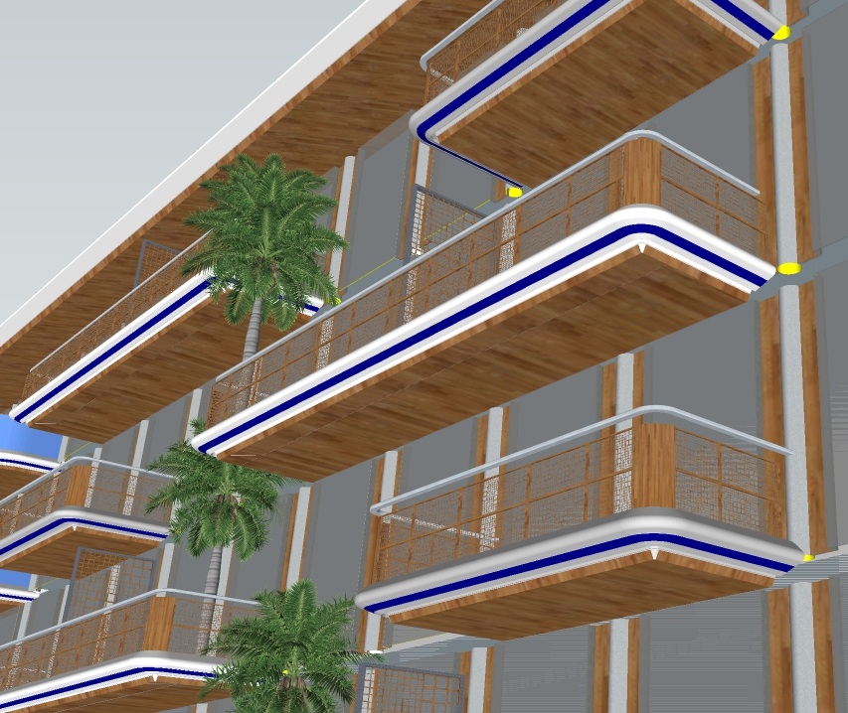
Balcony projection – with wooden perforated jali, metal rail & partition
Balcony projection – with wooden soffit, LED light running across the profile and colored band highlighting the projection
| ELEVATION WITH CURVED BALCONY – DETAIL 1

Slide 19
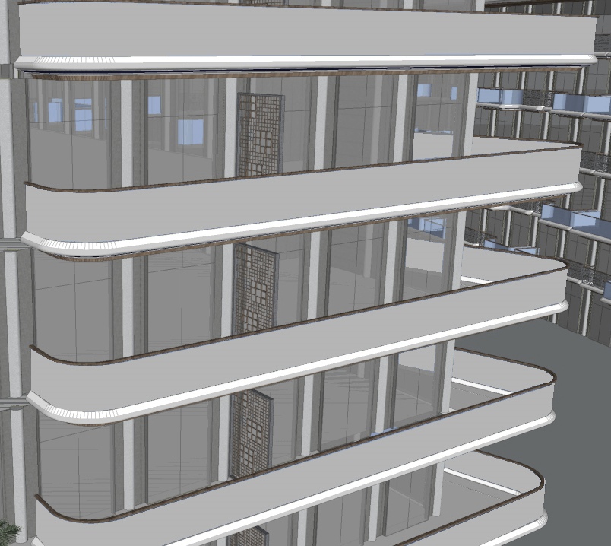
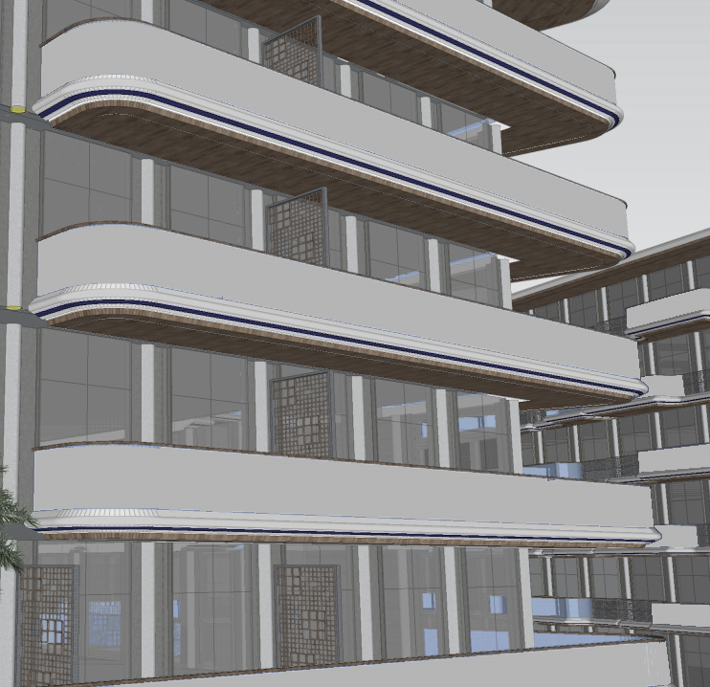
Balcony projection – with metal perforated jali, glass railing with wooden hand rail
Balcony projection – with wooden soffit, LED light running across the profile and colored band highlighting the projection
| ELEVATION WITH CURVED BALCONY – DETAIL 2

Slide 20
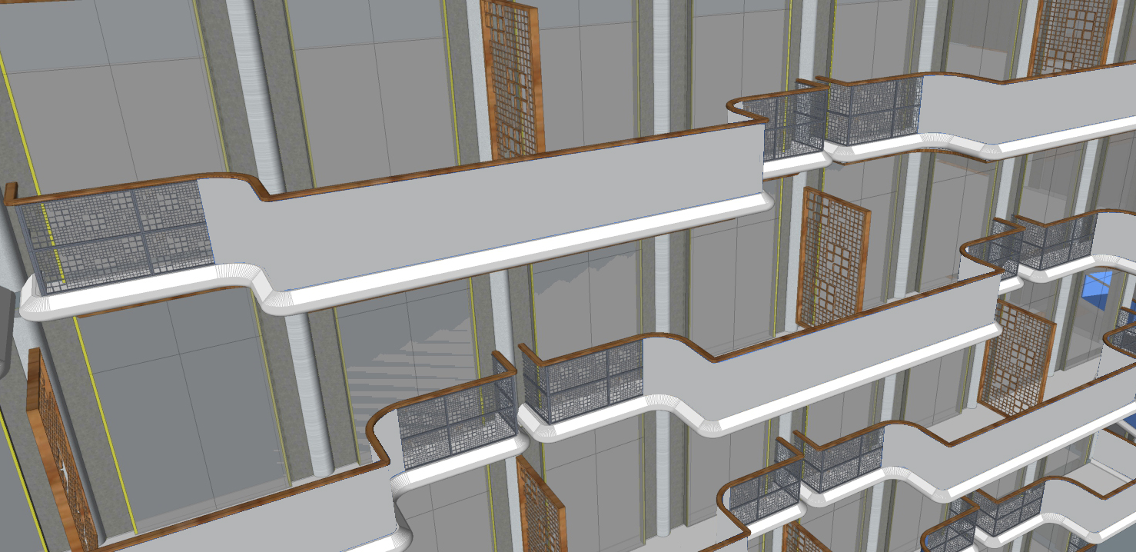
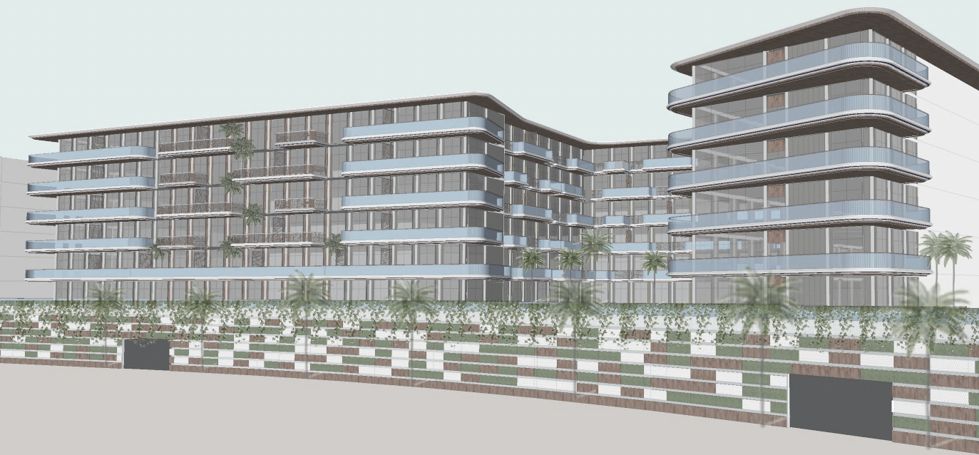
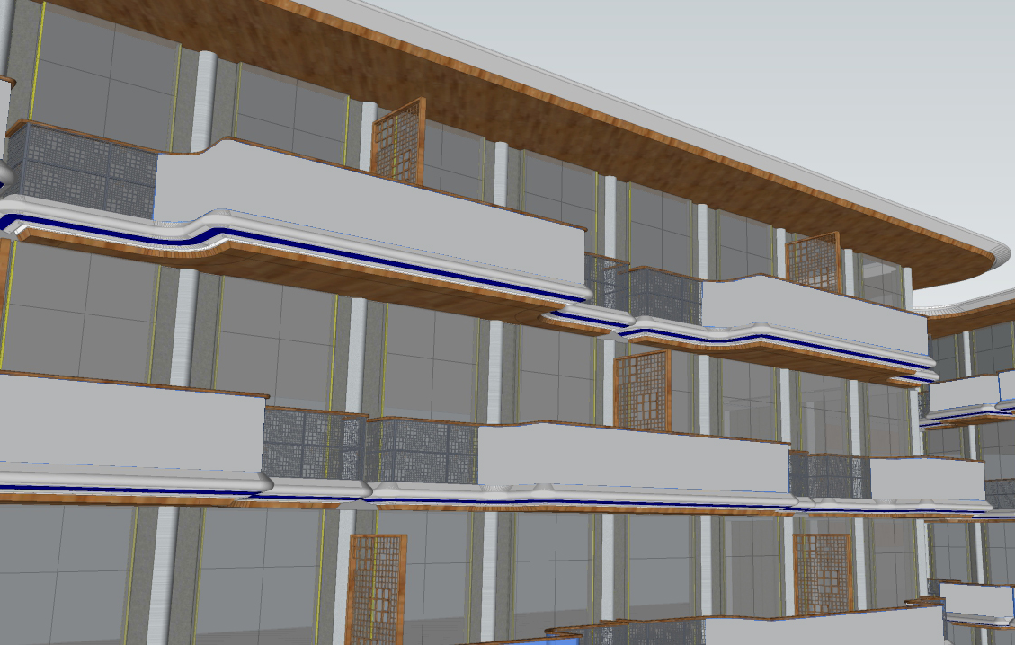
Balcony projection – with wooden perforated jali, combination of glass & metal perforated jali as parapet with wooden hand rail
Balcony projection – with wooden soffit, LED light running across the profile and colored band highlighting the projection
| ELEVATION WITH CURVED BALCONY – DETAIL 3

Slide 21
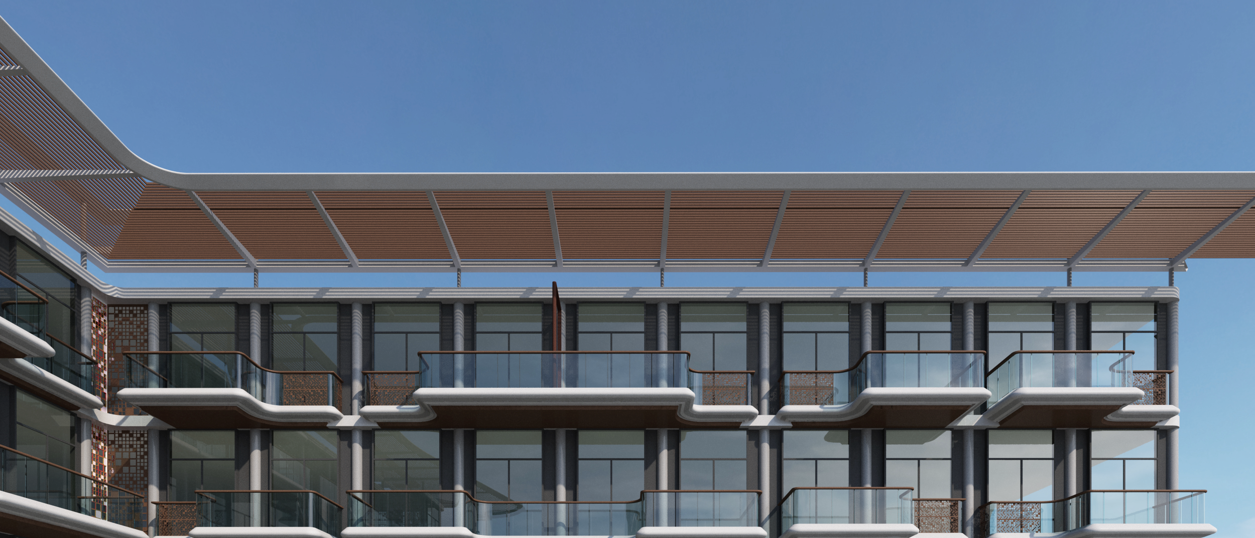
| ELEVATION WITH CURVED BALCONY – COURTYARD VIEW

Slide 22
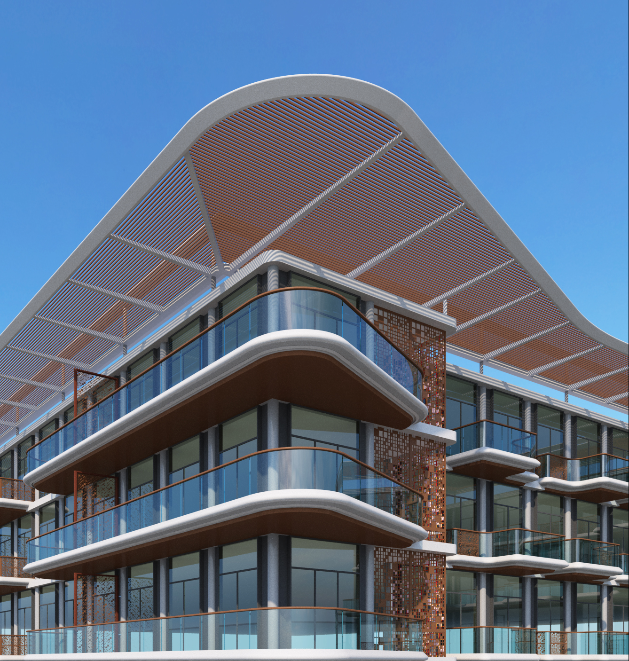
| ELEVATION WITH CURVED BALCONY – BLOWN UP VIEW

Slide 23
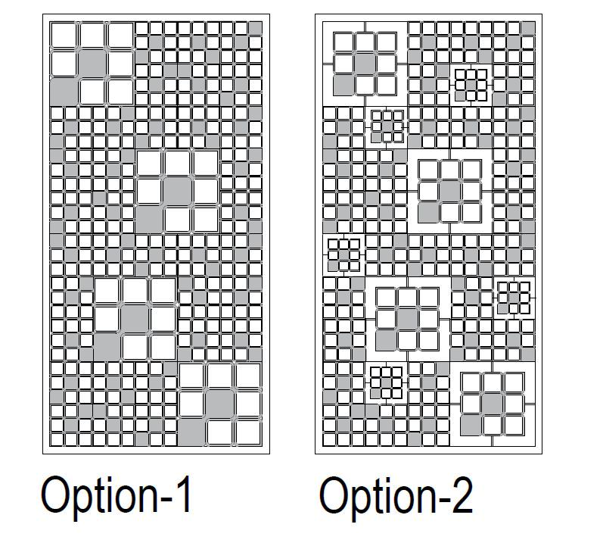

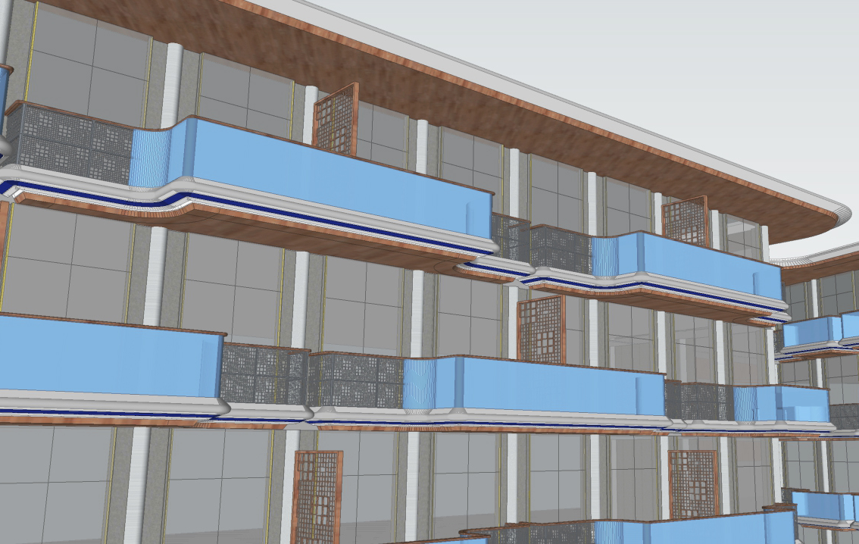
Opt 1
Opt 2
Jali design inspired by “GRID Logo”
| ELEVATION WITH CURVED BALCONY – DETAIL 4

Slide 24
ROOF PLAN
GRID

Slide 25
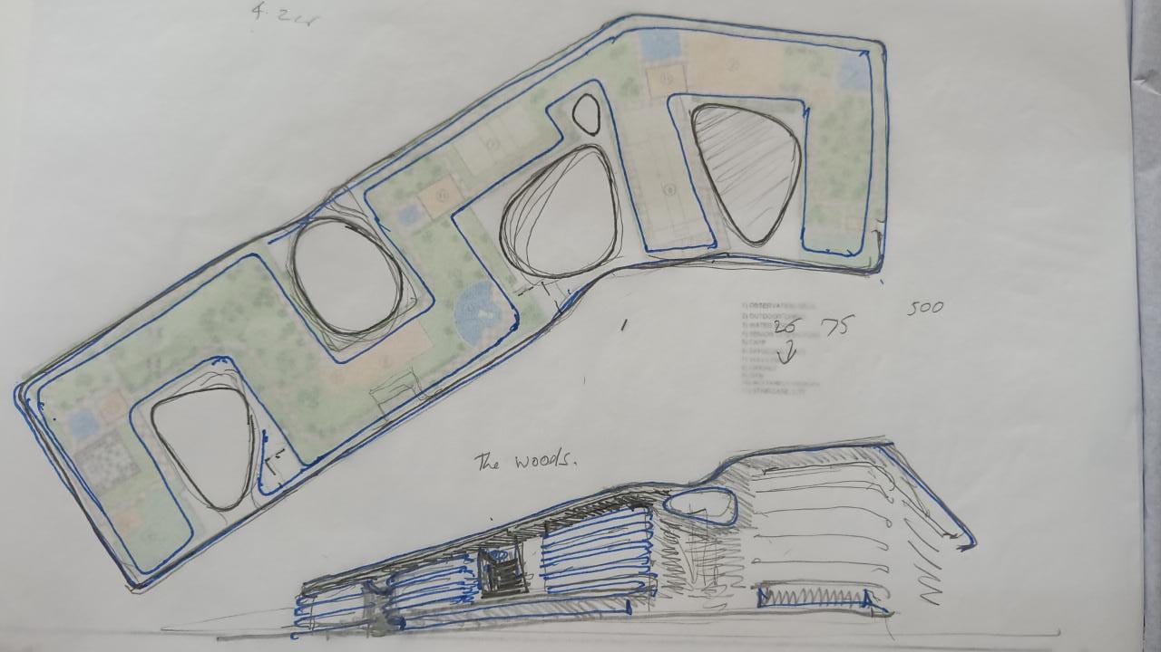
| EXTERIOR FACADE |ROOF PLAN

Slide 26
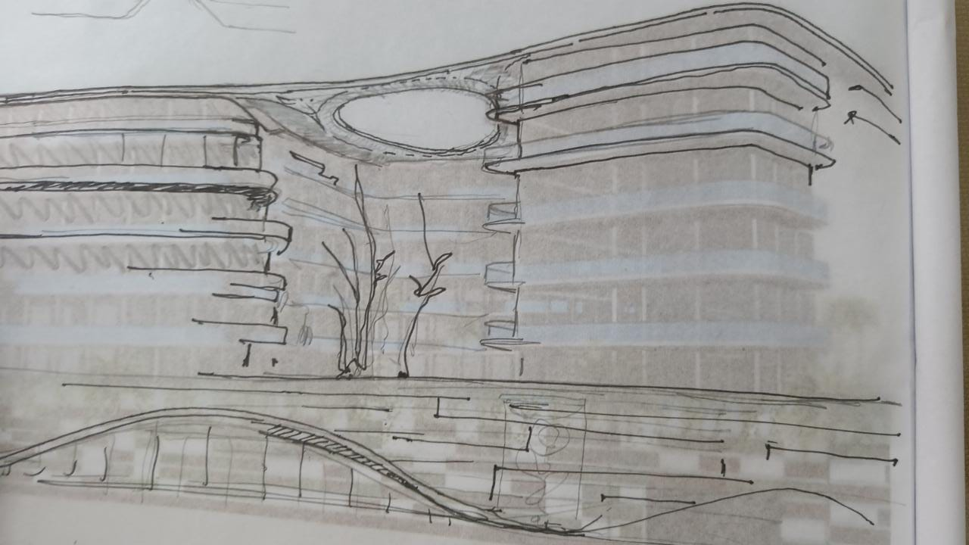
| EXTERIOR FACADE |ROOF PLAN

Slide 27
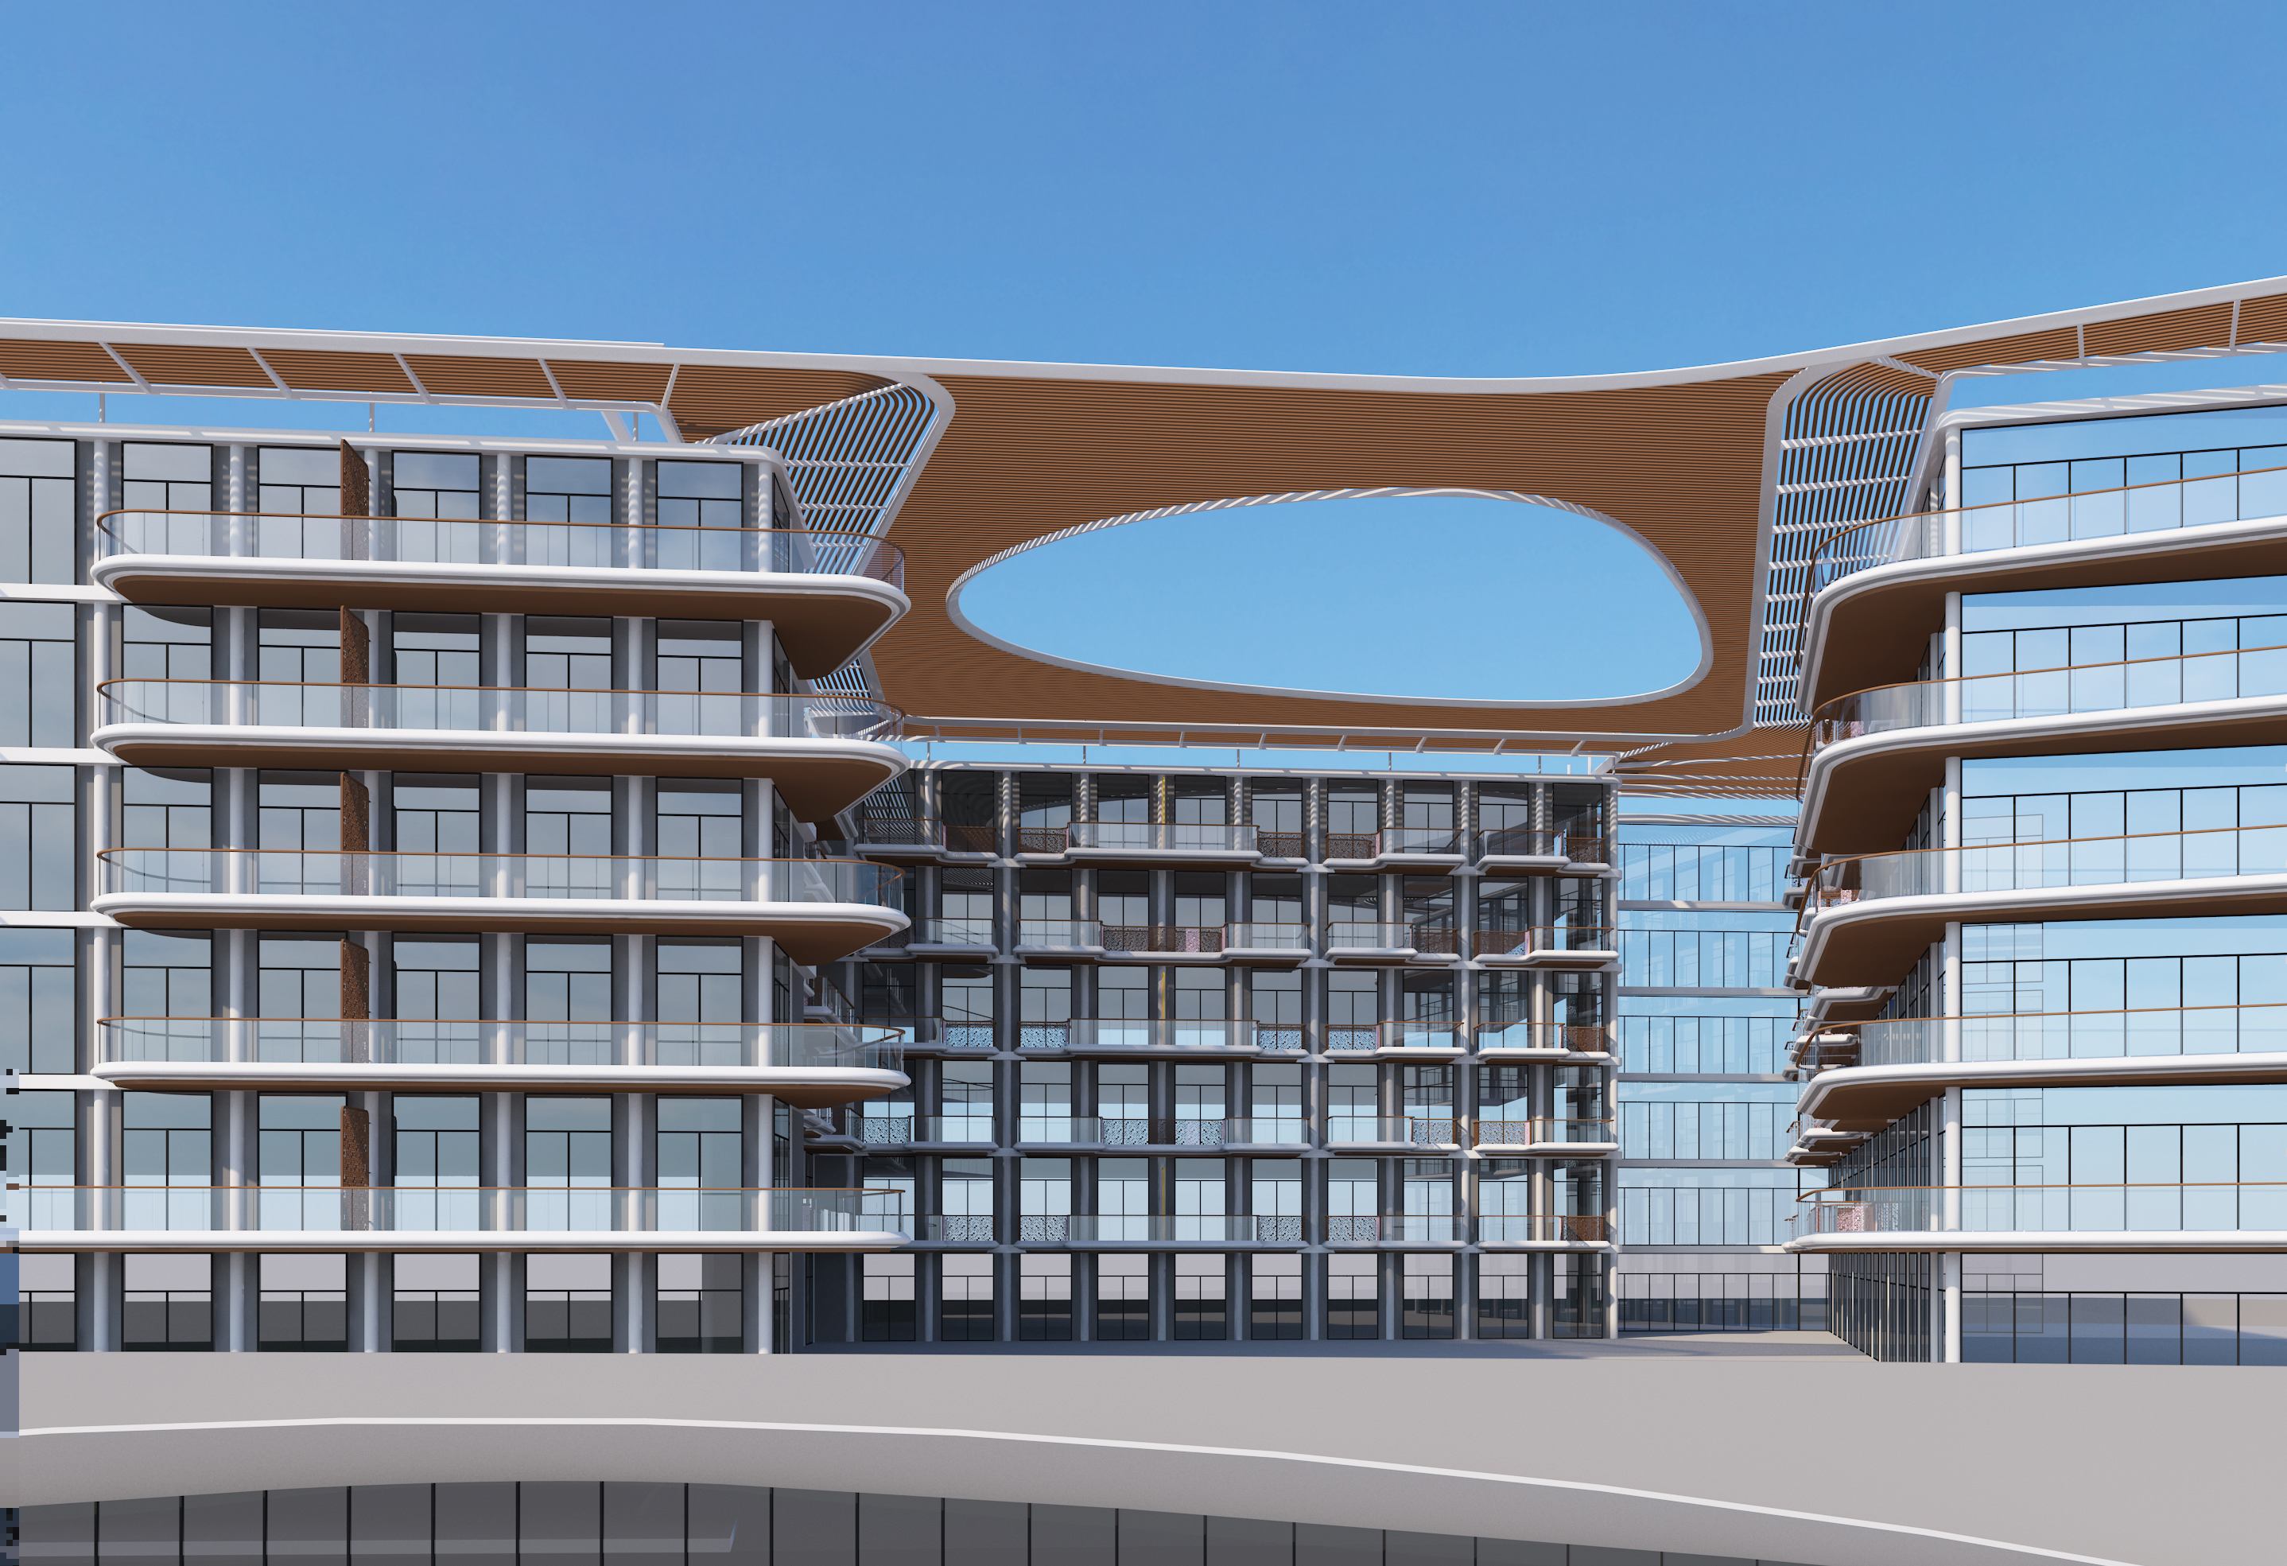
| EXTERIOR FACADE |ROOF PLAN

Slide 28
PODIUM REFERENCES
GRID

Slide 29
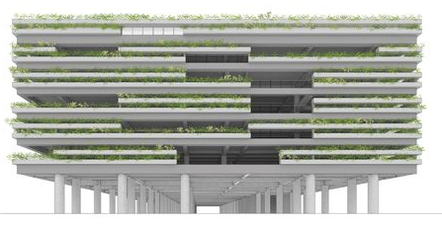
| EXTERIOR FACADE |REFERENCES

Slide 30
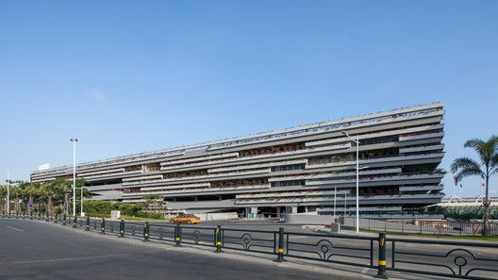
| EXTERIOR FACADE |REFERENCES

Slide 31
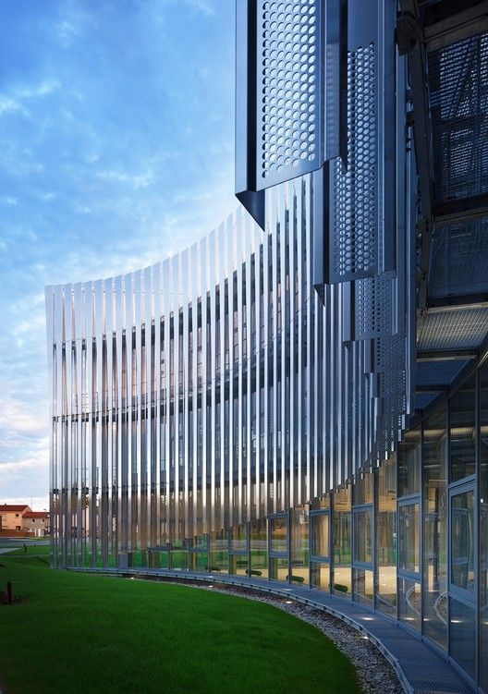
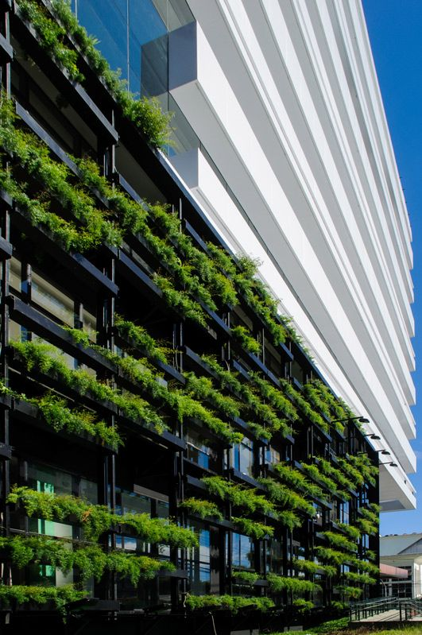
| EXTERIOR FACADE |REFERENCES

Slide 32
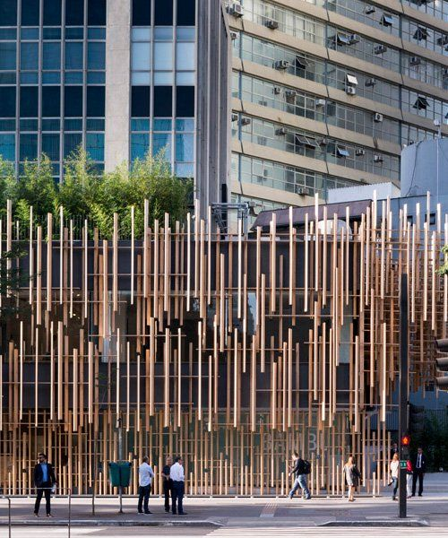
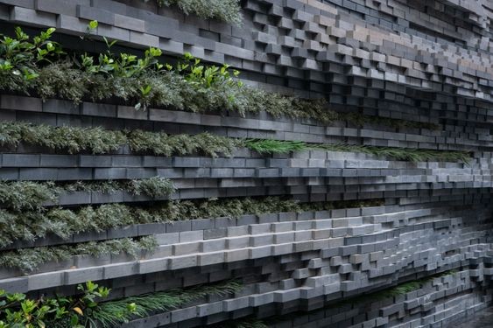
| EXTERIOR FACADE |REFERENCES

Slide 33
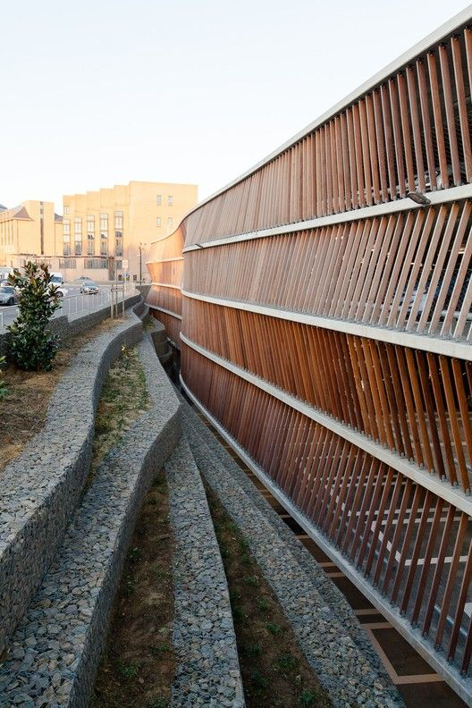
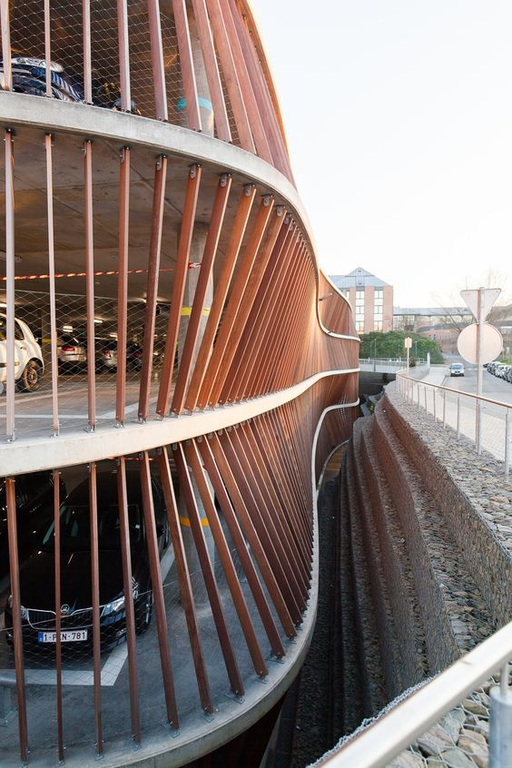
| EXTERIOR FACADE |REFERENCES

Slide 34
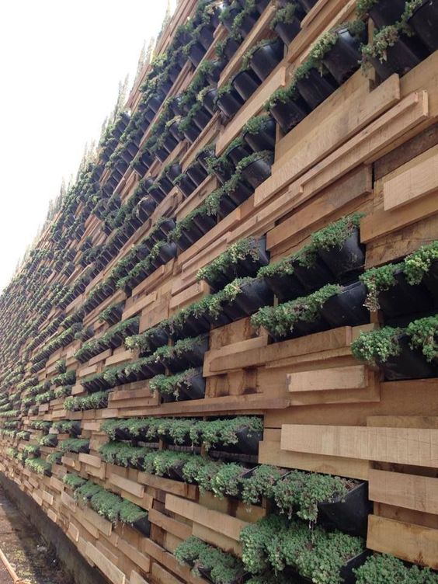
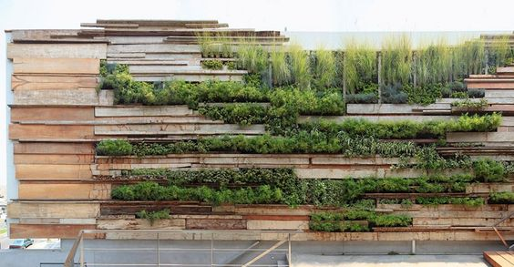
| EXTERIOR FACADE |REFERENCES

Slide 35
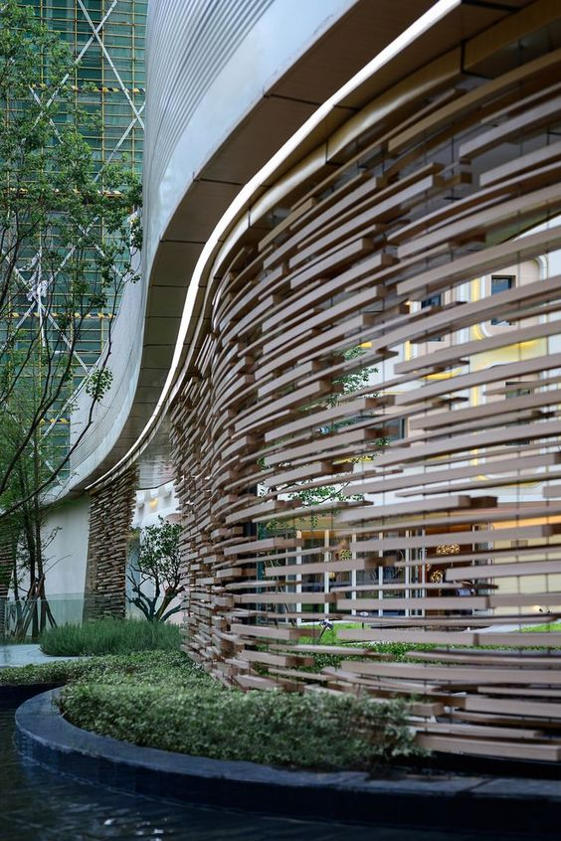
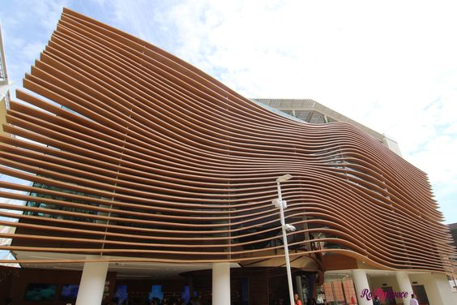
| EXTERIOR FACADE |REFERENCES

Slide 36
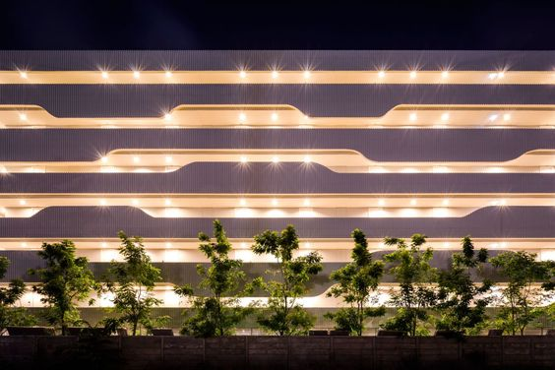
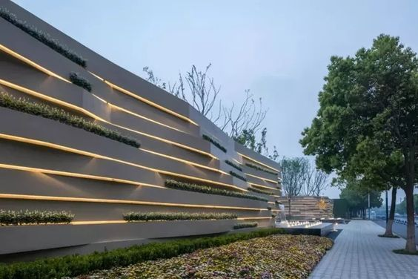
| EXTERIOR FACADE |REFERENCES

Slide 37
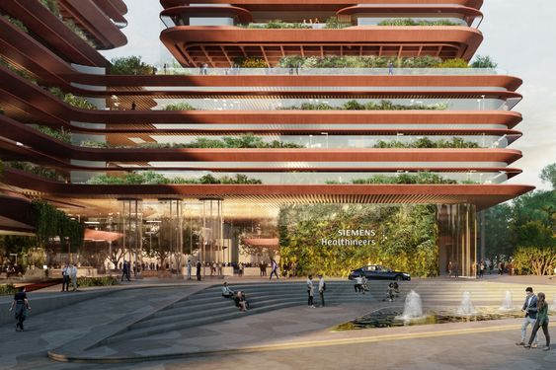
| EXTERIOR FACADE |REFERENCES

Slide 38
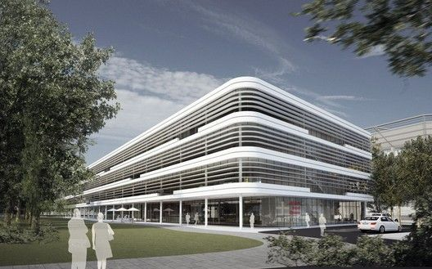
| EXTERIOR FACADE |REFERENCES

Slide 39
BALCONY REFERENCES
GRID

Slide 40
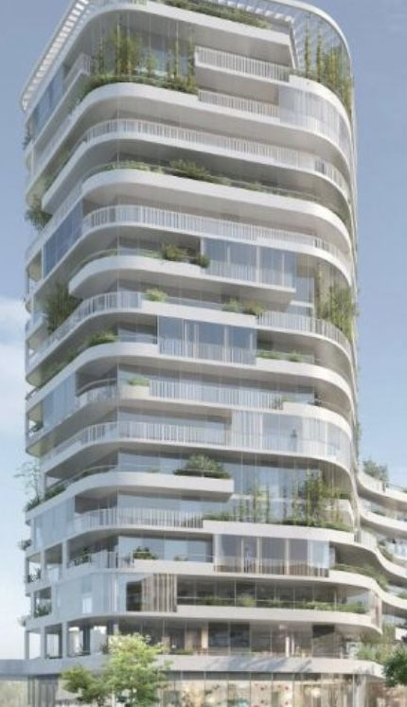
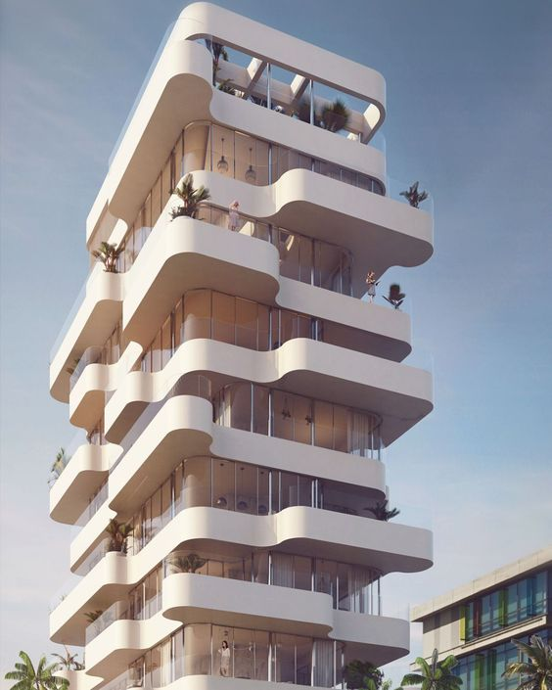
| EXTERIOR FACADE |REFERENCES

Slide 41
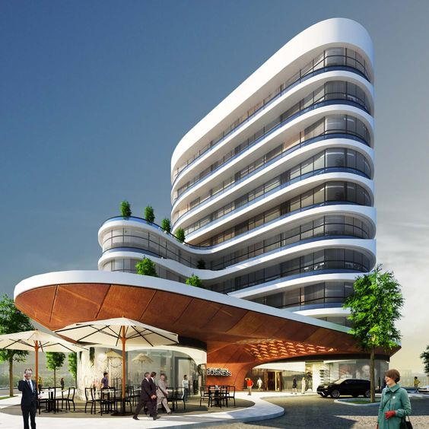
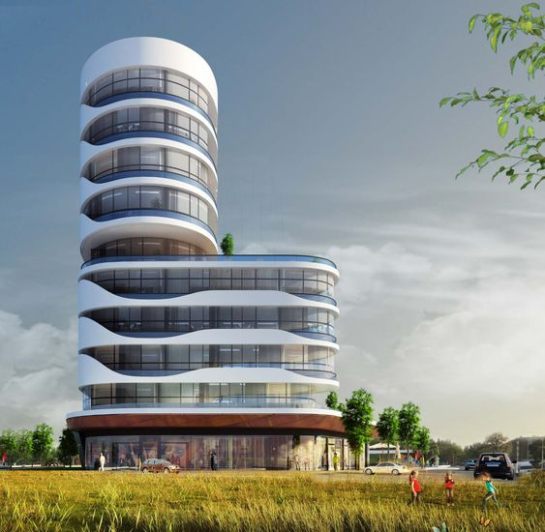
| EXTERIOR FACADE |REFERENCES

Slide 42

| EXTERIOR FACADE |REFERENCES

Slide 43

| EXTERIOR FACADE |REFERENCES

Slide 44


| EXTERIOR FACADE |REFERENCES

Slide 45


| EXTERIOR FACADE |REFERENCES

Slide 46


| EXTERIOR FACADE |REFERENCES

Slide 47
THANK YOU

