Slide 1
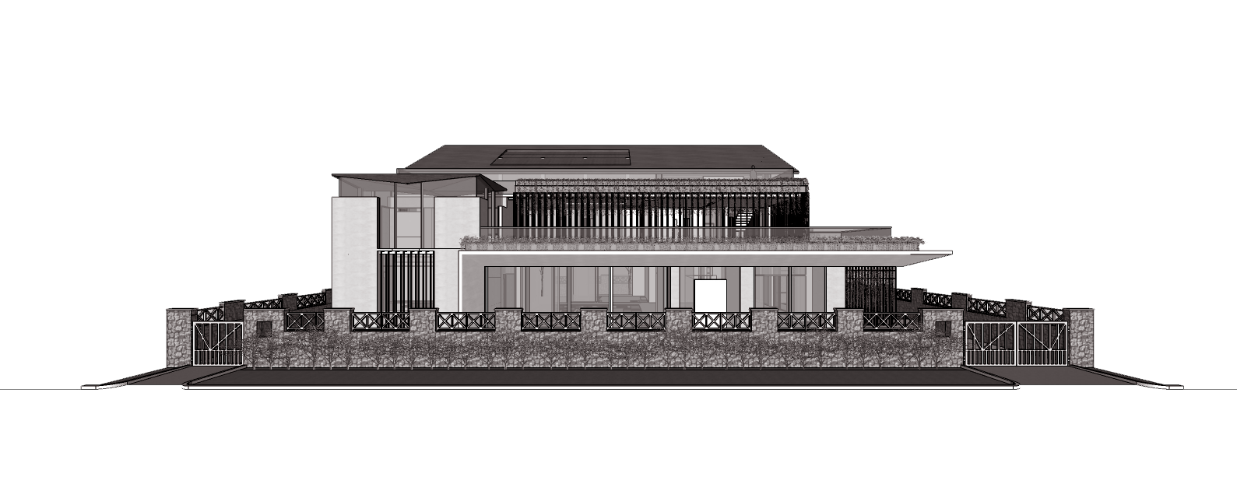
RESIDENCE OF MRS JYOTI & MR. SHEKHAR REDDY, HYDERABAD
SCHEMATIC DESIGN PROPOSAL
June 2022

Slide 2
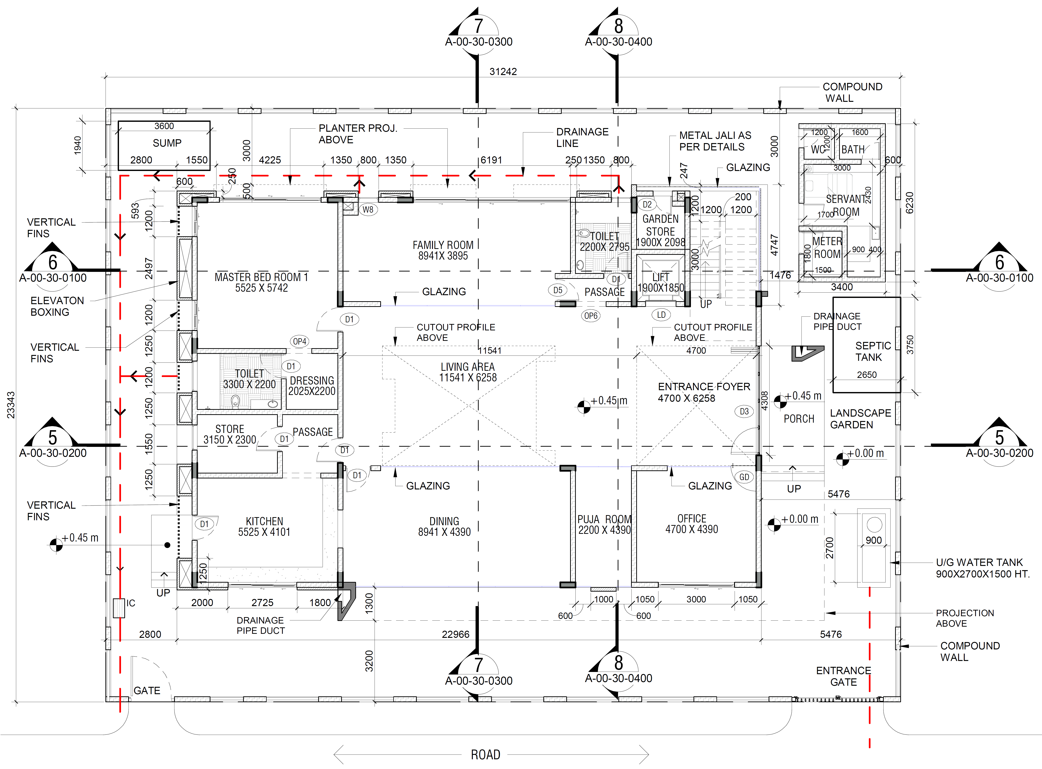
Ground Floor Plan
| RESIDENCE OF MRS JYOTI & MR. SHEKHAR REDDY |

Slide 3
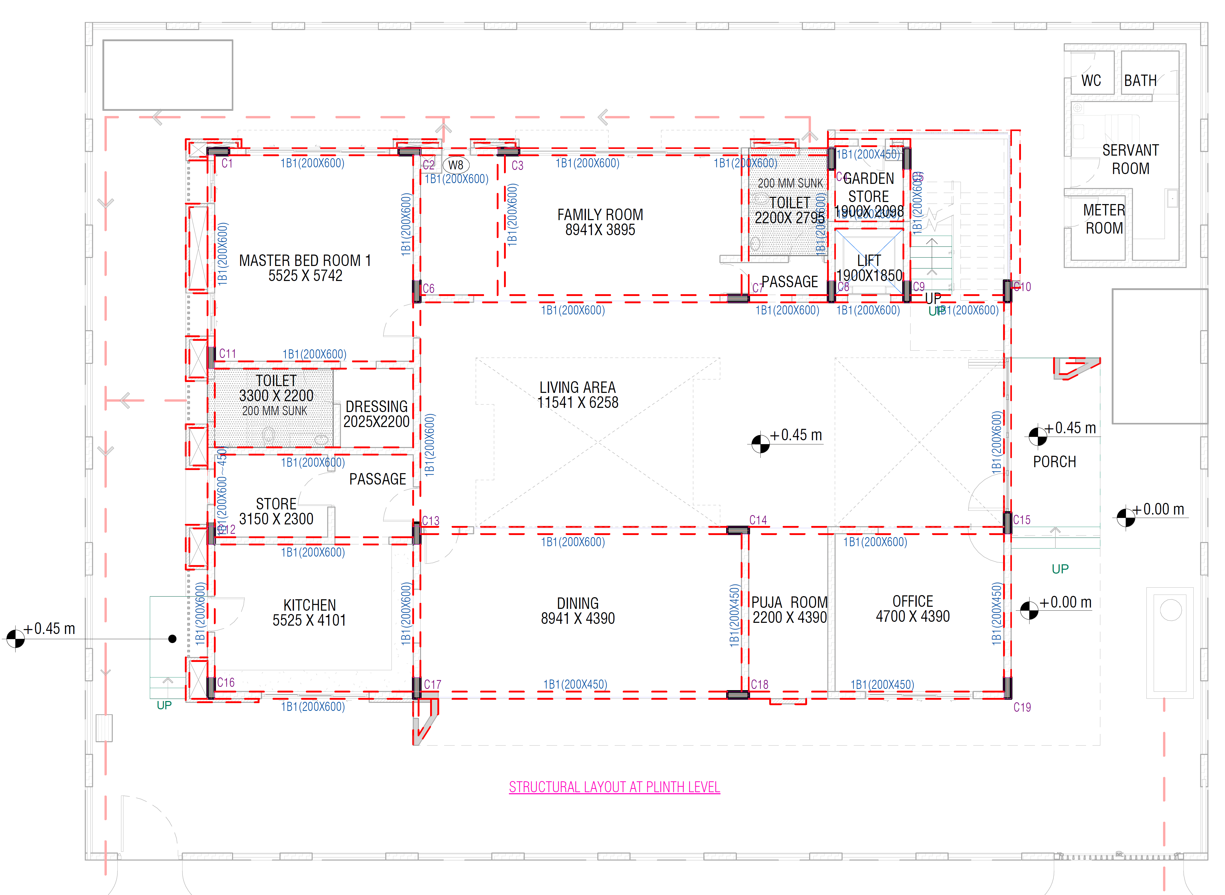
Ground Floor-
Beam Layout
| RESIDENCE OF MRS JYOTI & MR. SHEKHAR REDDY |

Slide 4
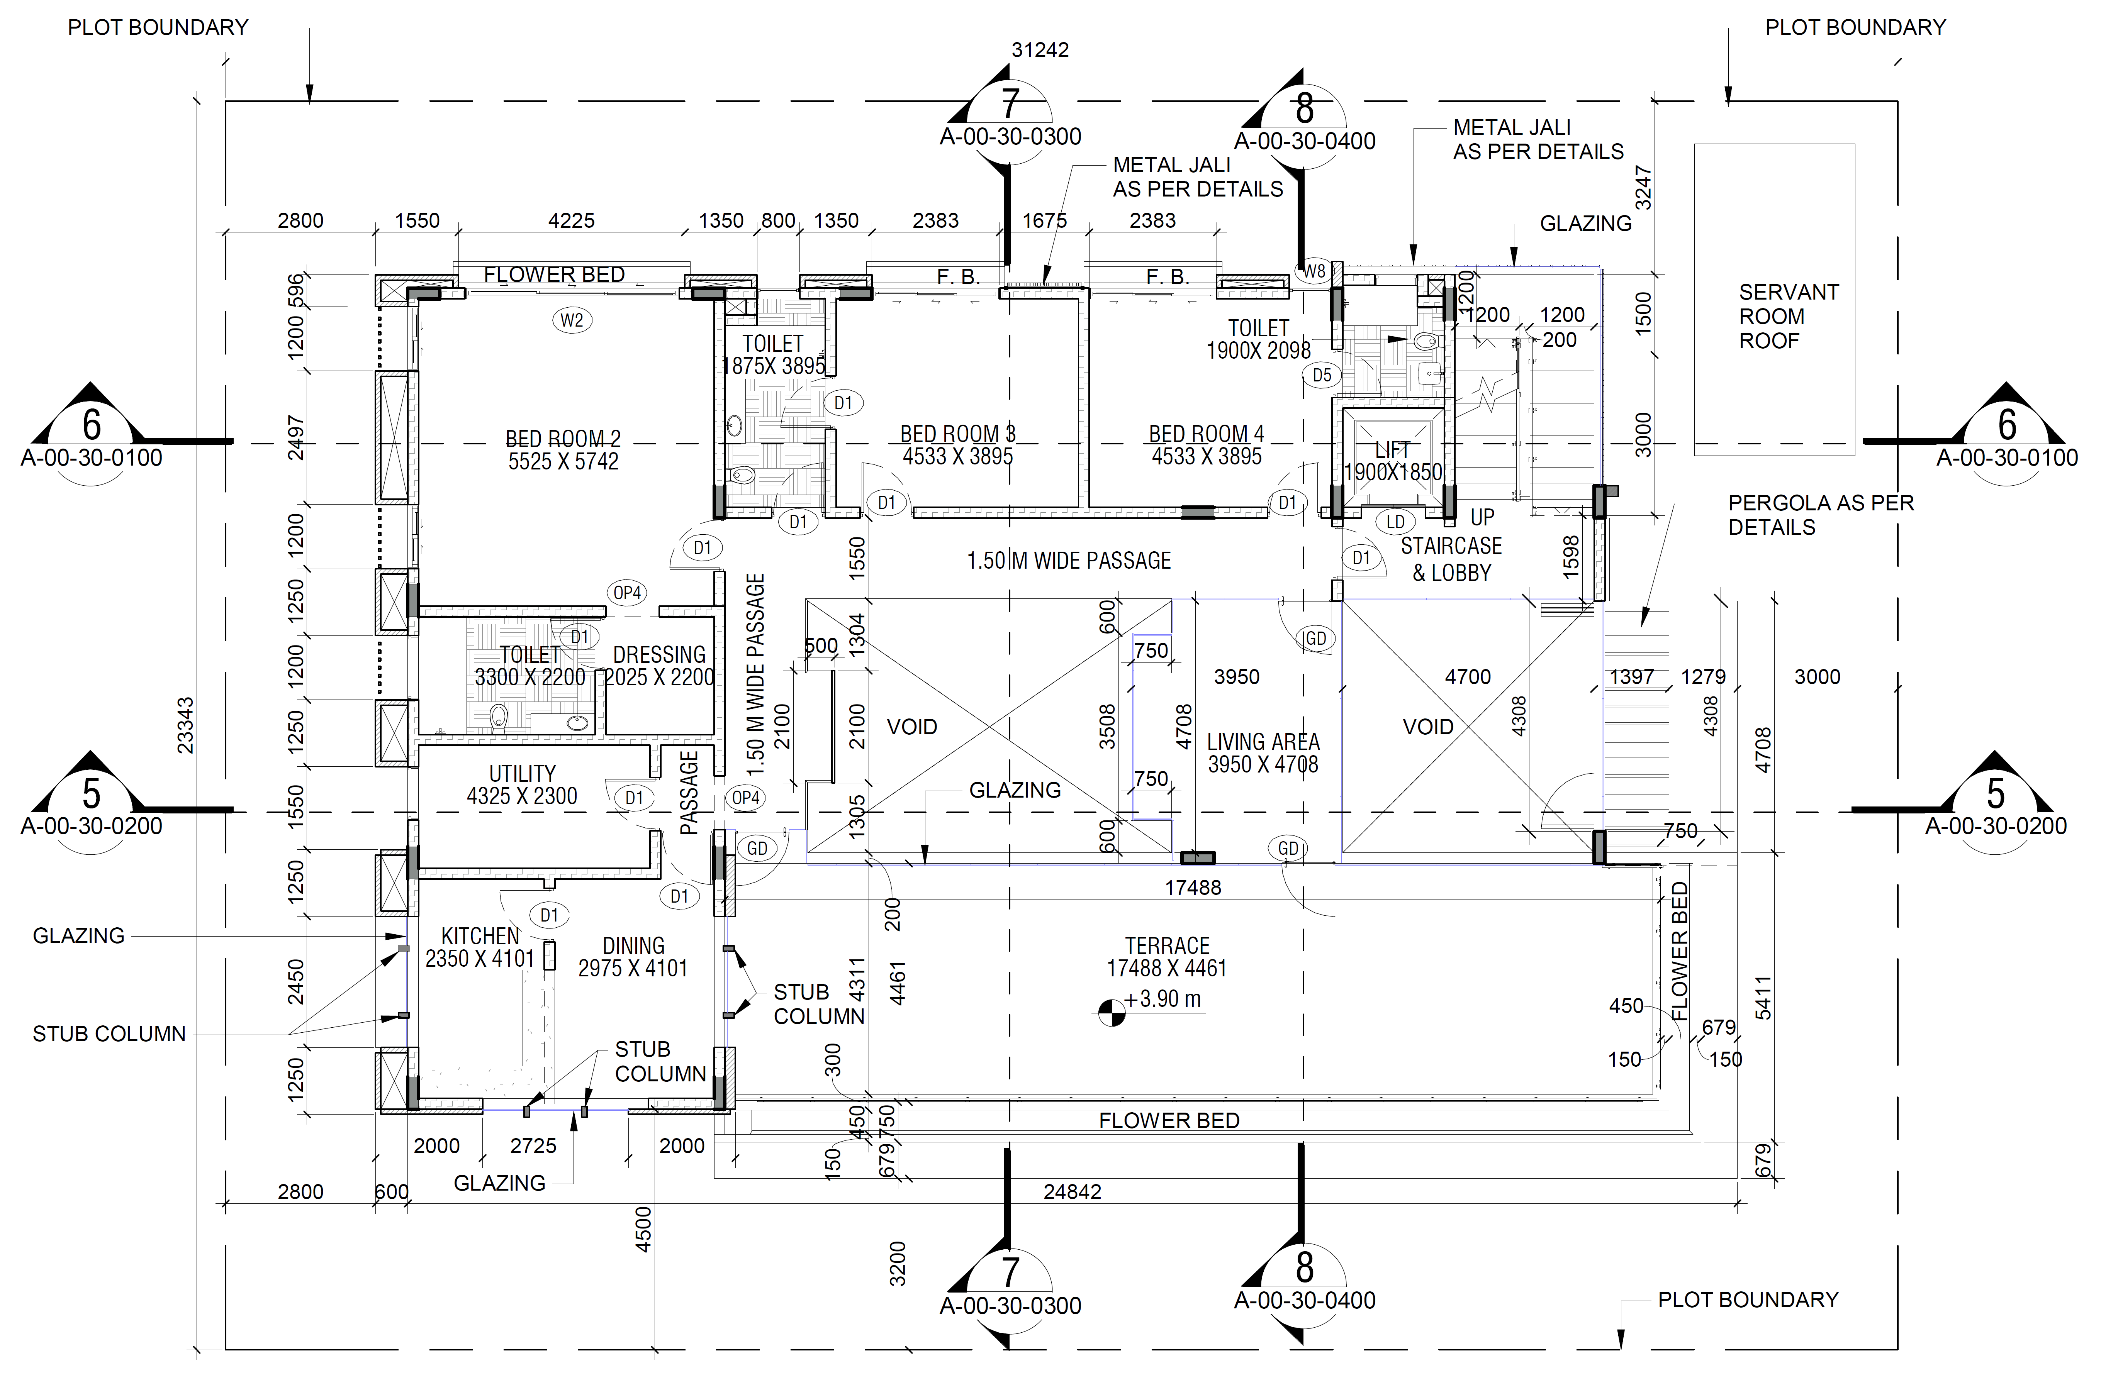
First Floor Plan
| RESIDENCE OF MRS JYOTI & MR. SHEKHAR REDDY |

Slide 5
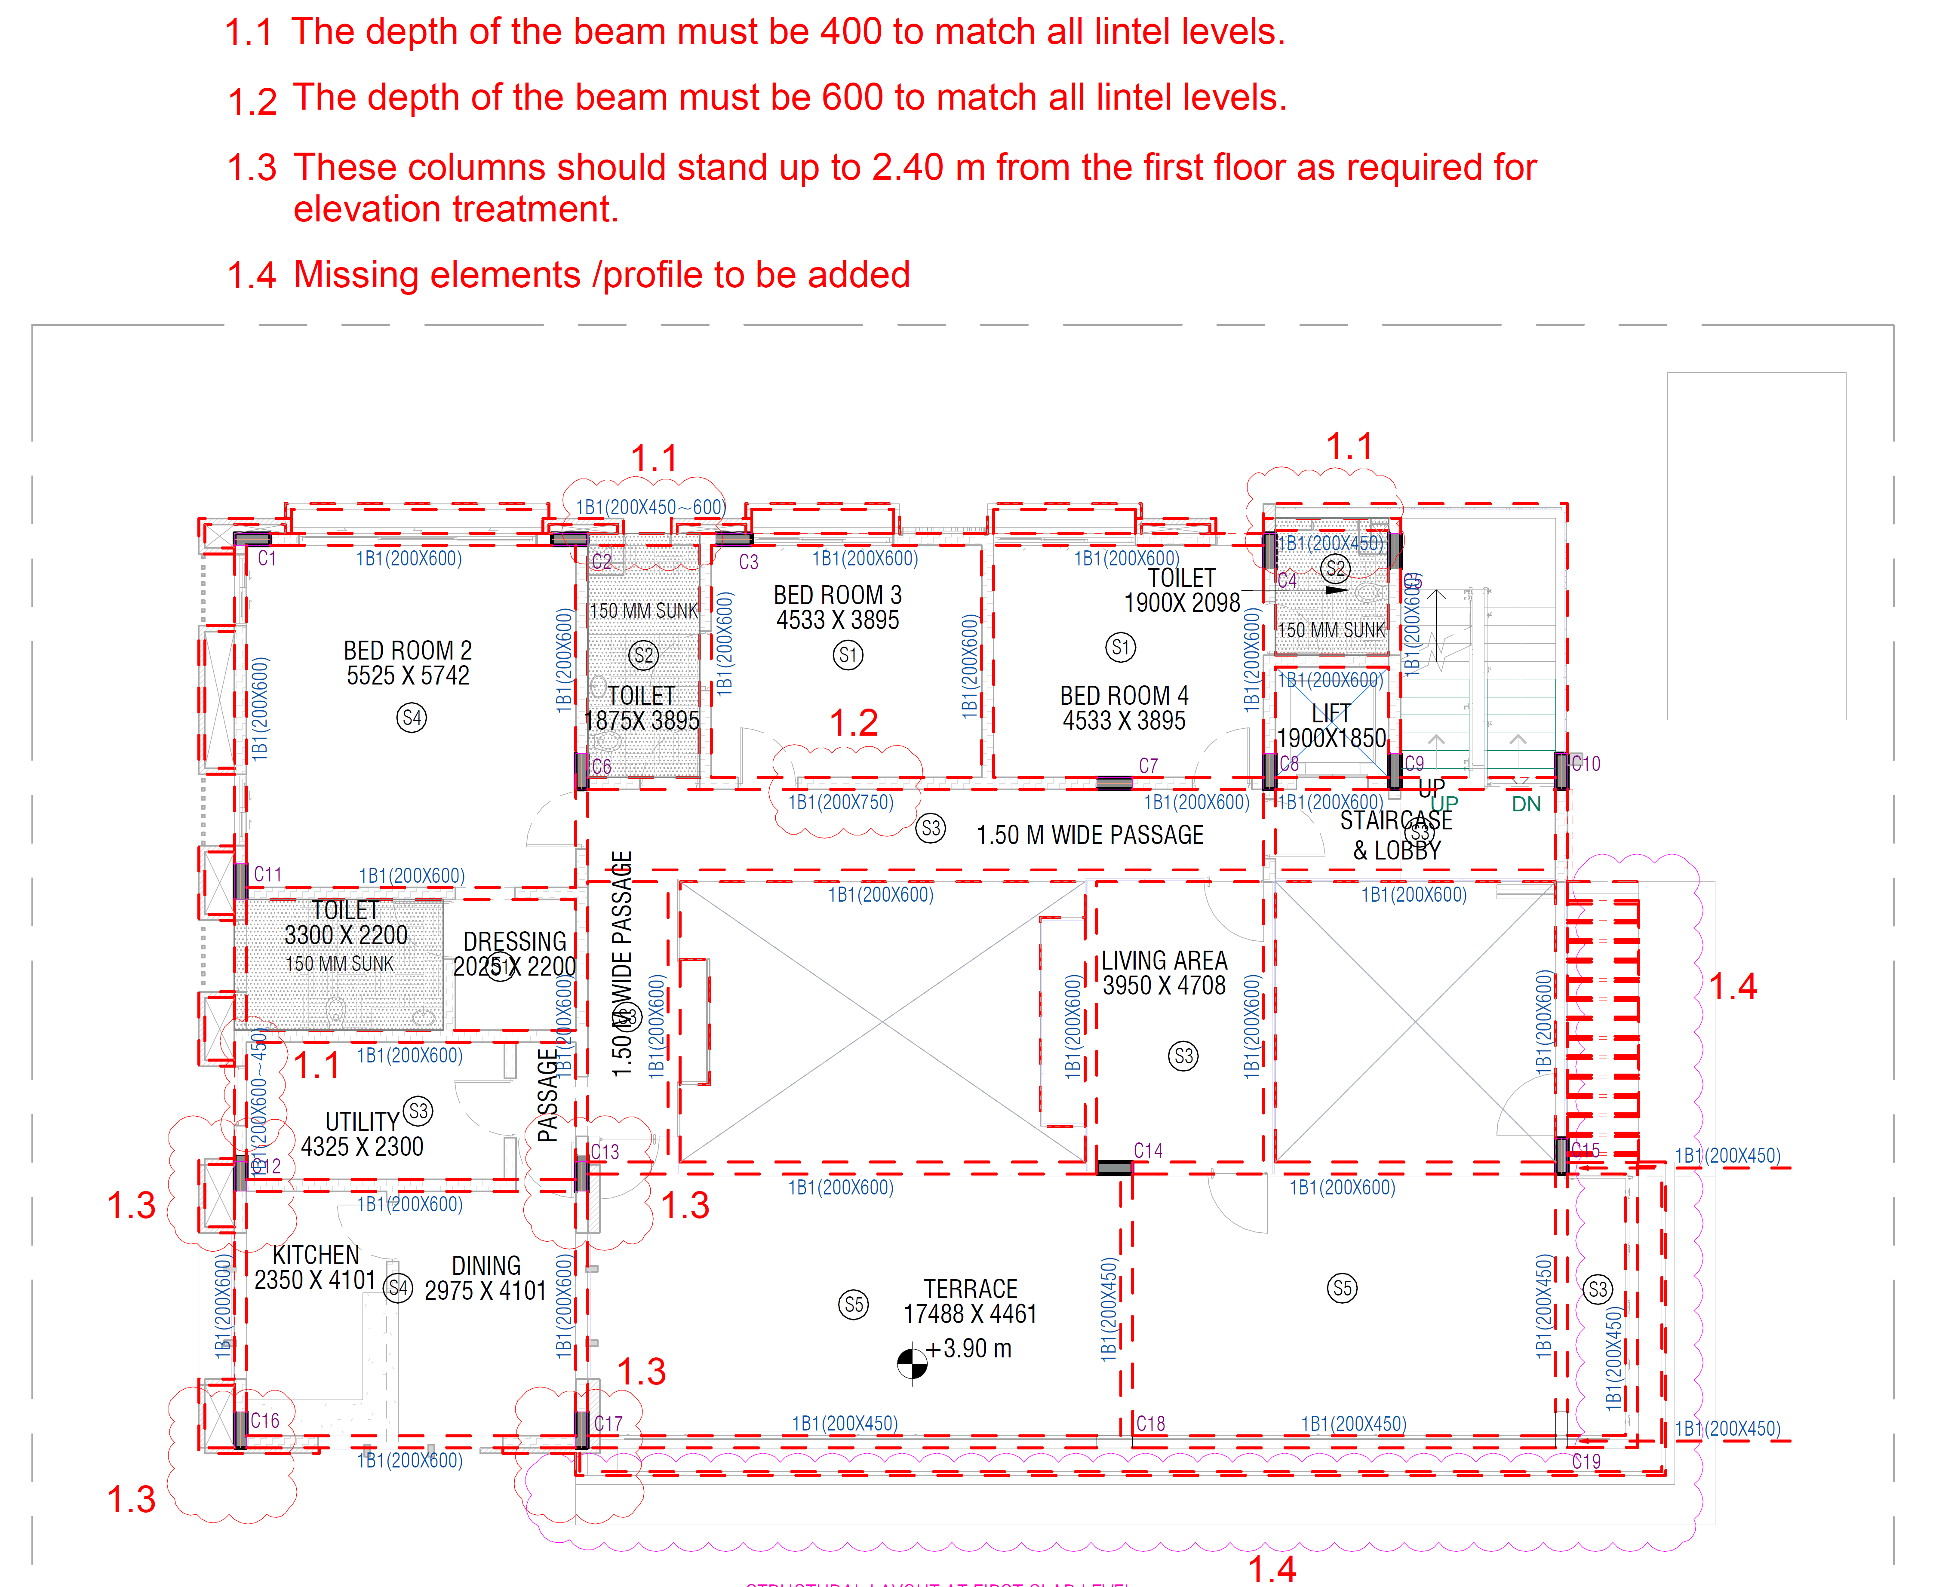
First Floor –
Beam Layout
Proposed by IBS
| RESIDENCE OF MRS JYOTI & MR. SHEKHAR REDDY |

Slide 6
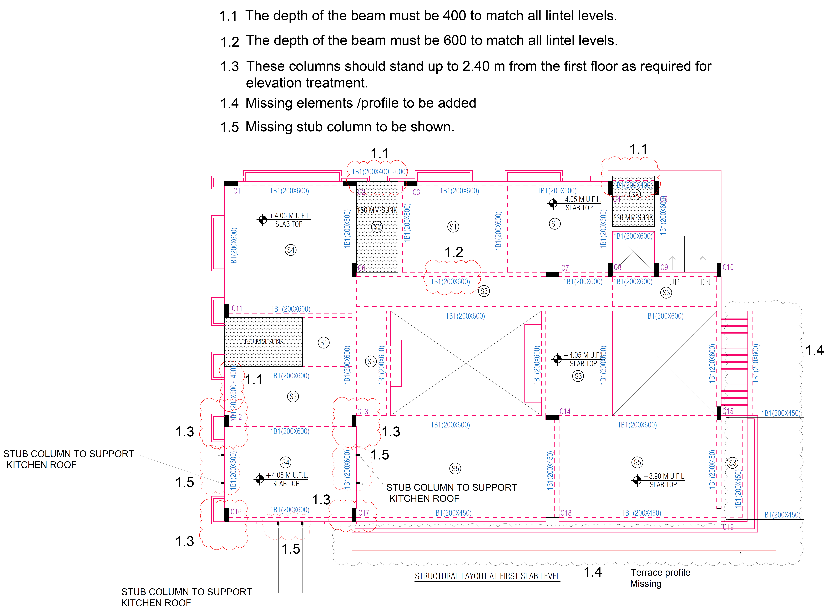
First Floor –
Beam Layout VAMA
| RESIDENCE OF MRS JYOTI & MR. SHEKHAR REDDY |

Slide 7
Terrace Floor Plan
| RESIDENCE OF MRS JYOTI & MR. SHEKHAR REDDY |

Slide 8
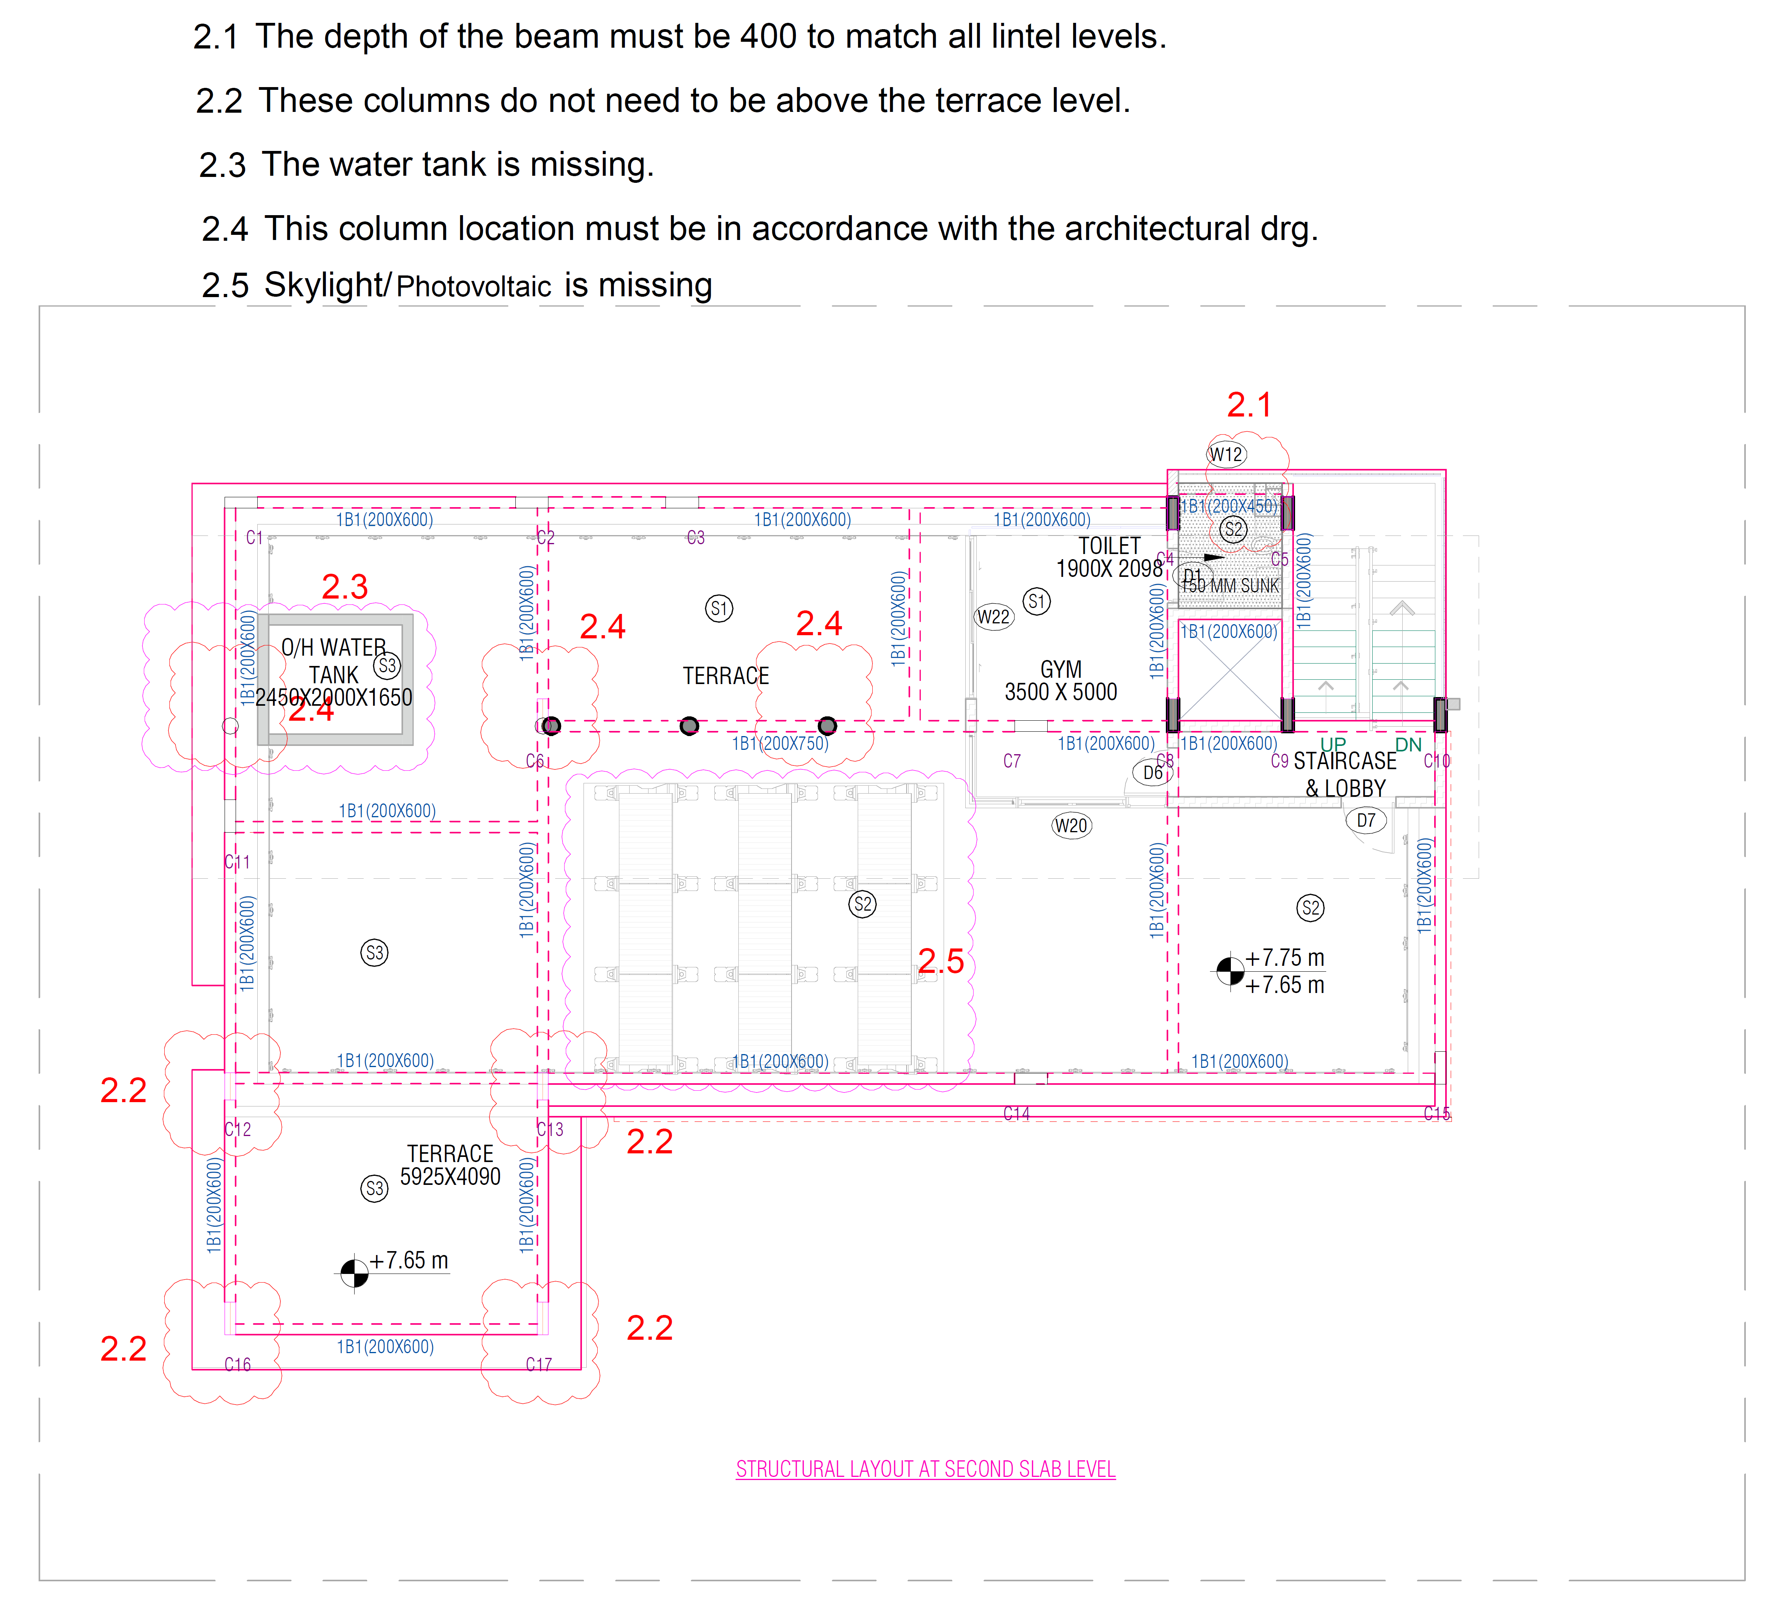
Terrace Floor –
Beam layout
Proposed by IBS
| RESIDENCE OF MRS JYOTI & MR. SHEKHAR REDDY |

Slide 9
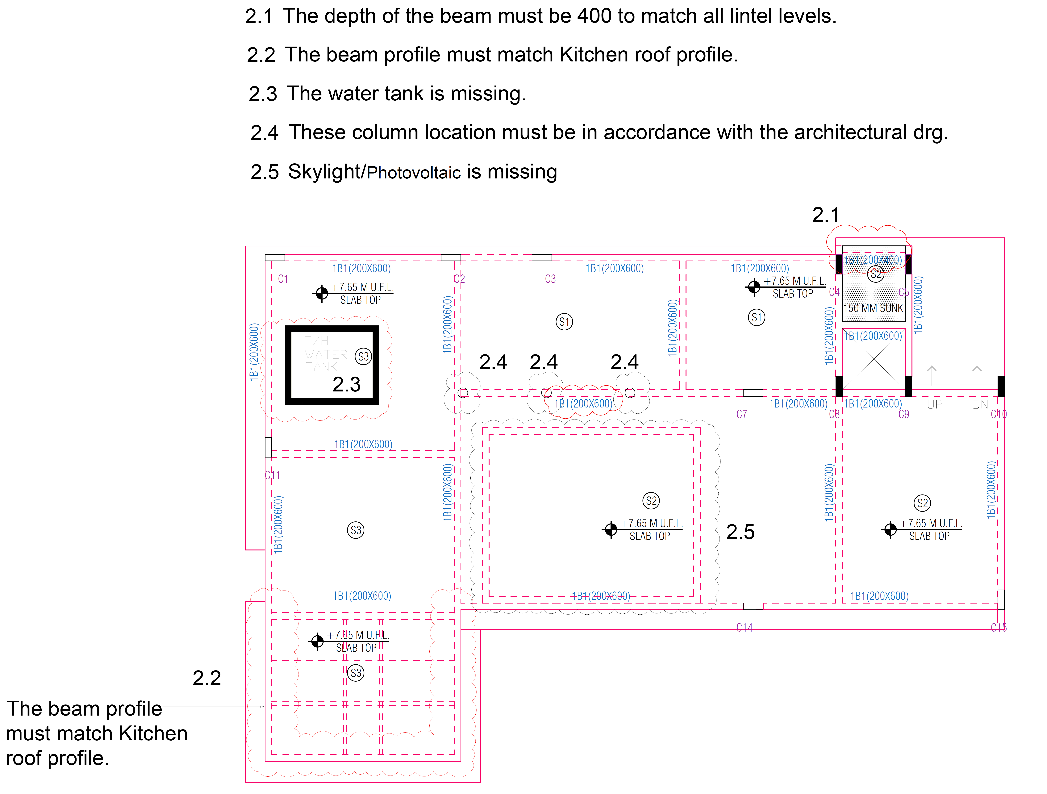
Terrace Floor –
Beam layout VAMA
| RESIDENCE OF MRS JYOTI & MR. SHEKHAR REDDY |

Slide 10
Roof Plan
| RESIDENCE OF MRS JYOTI & MR. SHEKHAR REDDY |

Slide 11
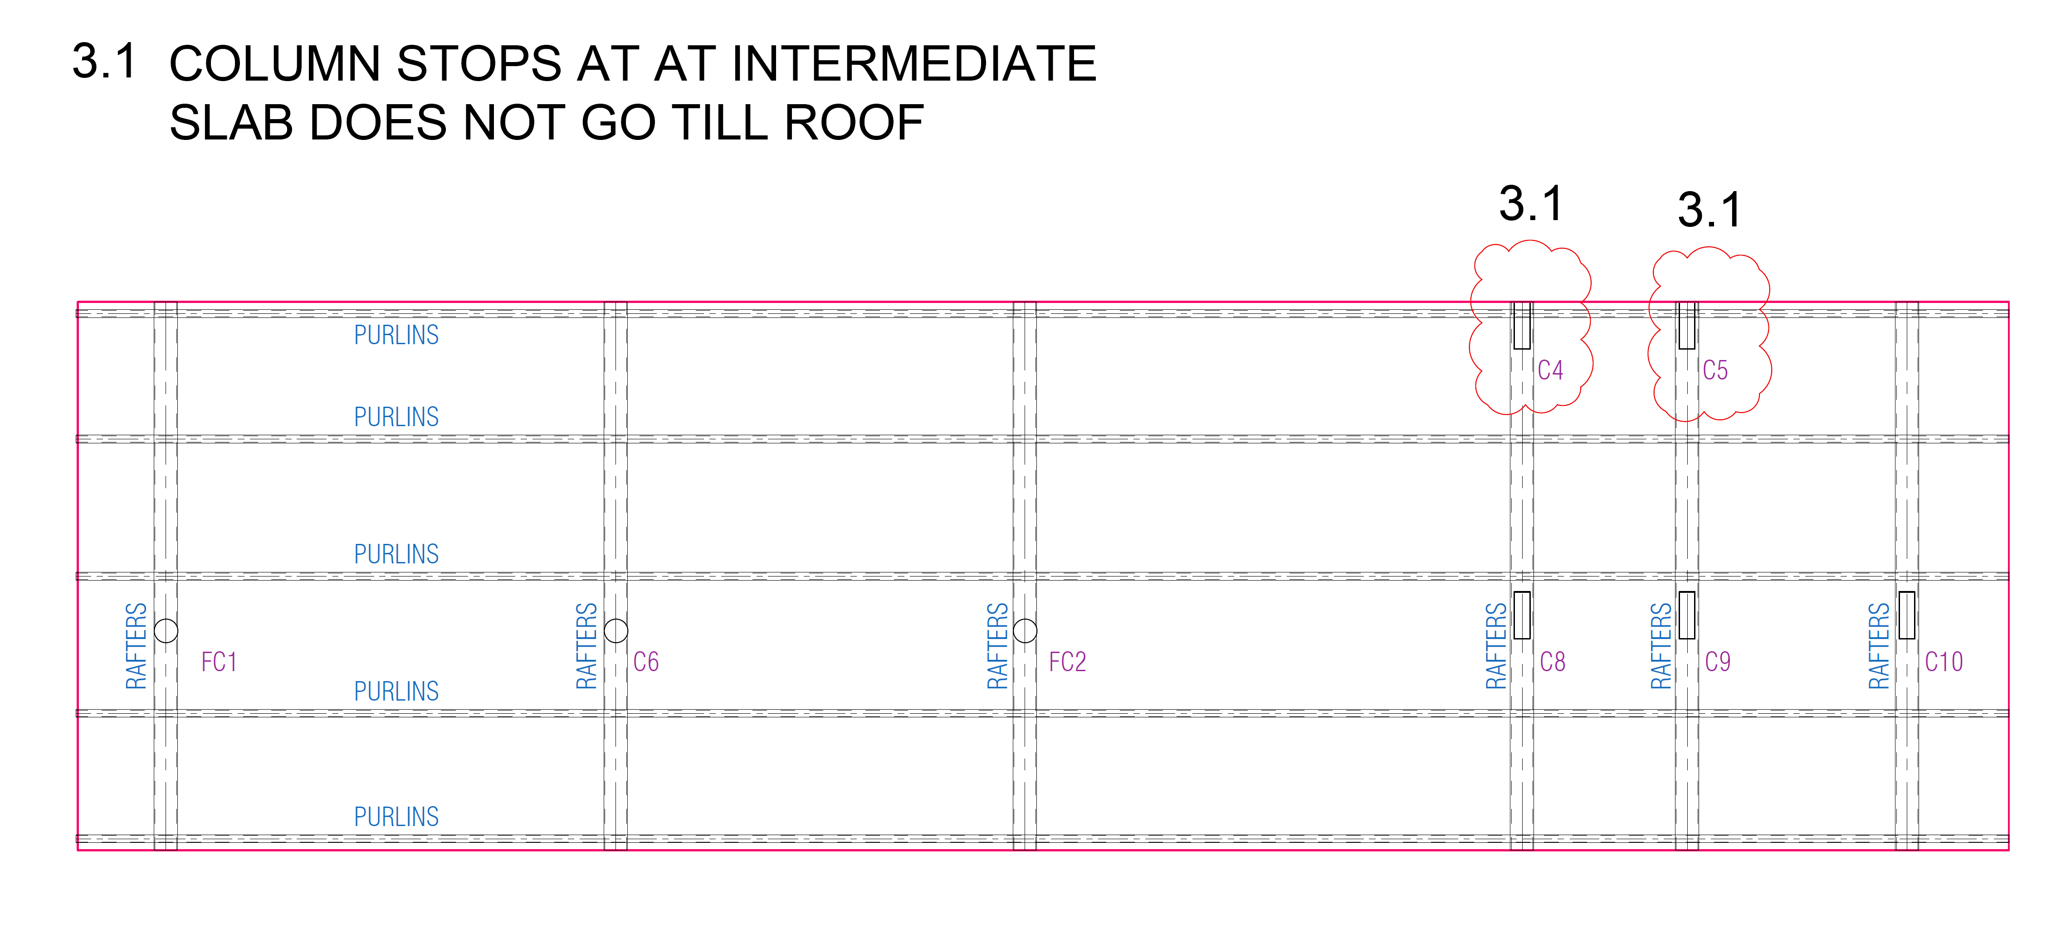
Roof Plan
Beam layout
Proposed by IBS
| RESIDENCE OF MRS JYOTI & MR. SHEKHAR REDDY |

Slide 12
Roof Plan
Beam layout VAMA
| RESIDENCE OF MRS JYOTI & MR. SHEKHAR REDDY |

Slide 13
East elevation
| RESIDENCE OF MRS JYOTI & MR. SHEKHAR REDDY |

Slide 14
South Elevation
| RESIDENCE OF MRS JYOTI & MR. SHEKHAR REDDY |

Slide 15
North Elevation
| RESIDENCE OF MRS JYOTI & MR. SHEKHAR REDDY |

Slide 16
West Elevation
| RESIDENCE OF MRS JYOTI & MR. SHEKHAR REDDY |

Slide 17
Section -5
| RESIDENCE OF MRS JYOTI & MR. SHEKHAR REDDY |

Slide 18
Section -6
| RESIDENCE OF MRS JYOTI & MR. SHEKHAR REDDY |

Slide 19
Section -7
| RESIDENCE OF MRS JYOTI & MR. SHEKHAR REDDY |

Slide 20
Section -8
| RESIDENCE OF MRS JYOTI & MR. SHEKHAR REDDY |

Slide 21
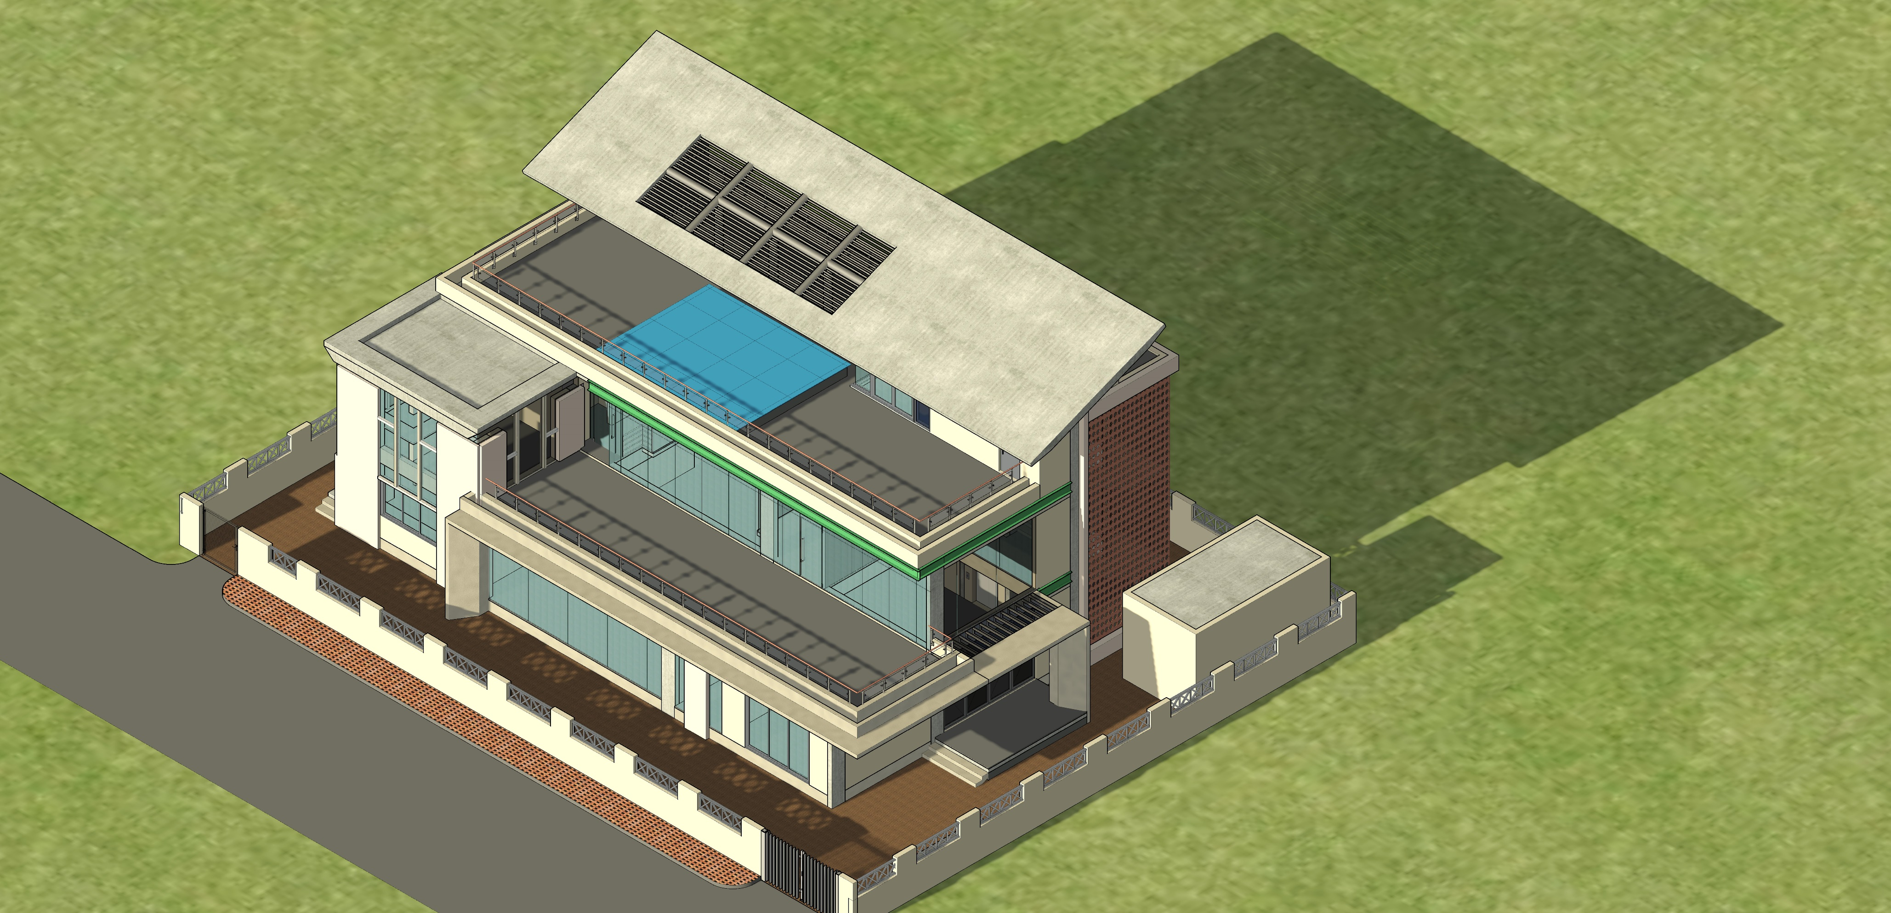
Views
| RESIDENCE OF MRS JYOTI & MR. SHEKHAR REDDY |

Slide 22
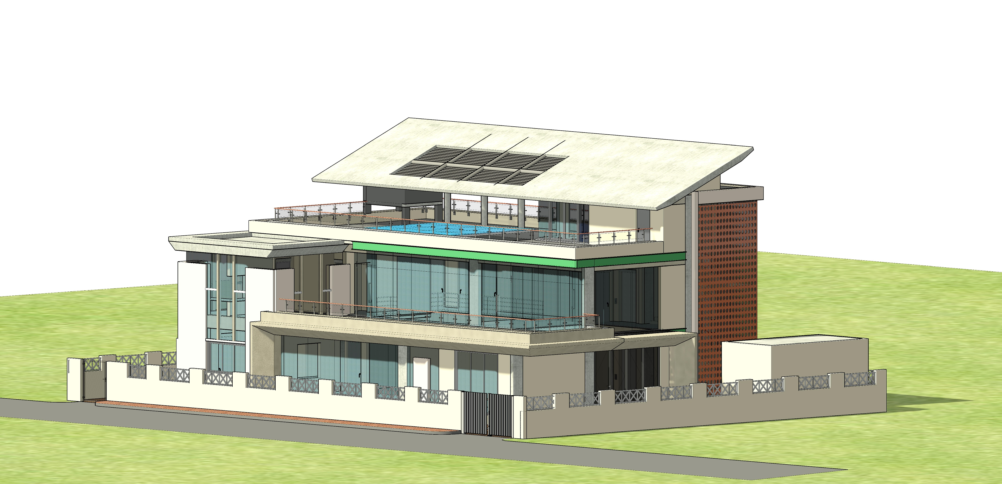
Views
| RESIDENCE OF MRS JYOTI & MR. SHEKHAR REDDY |

Slide 23
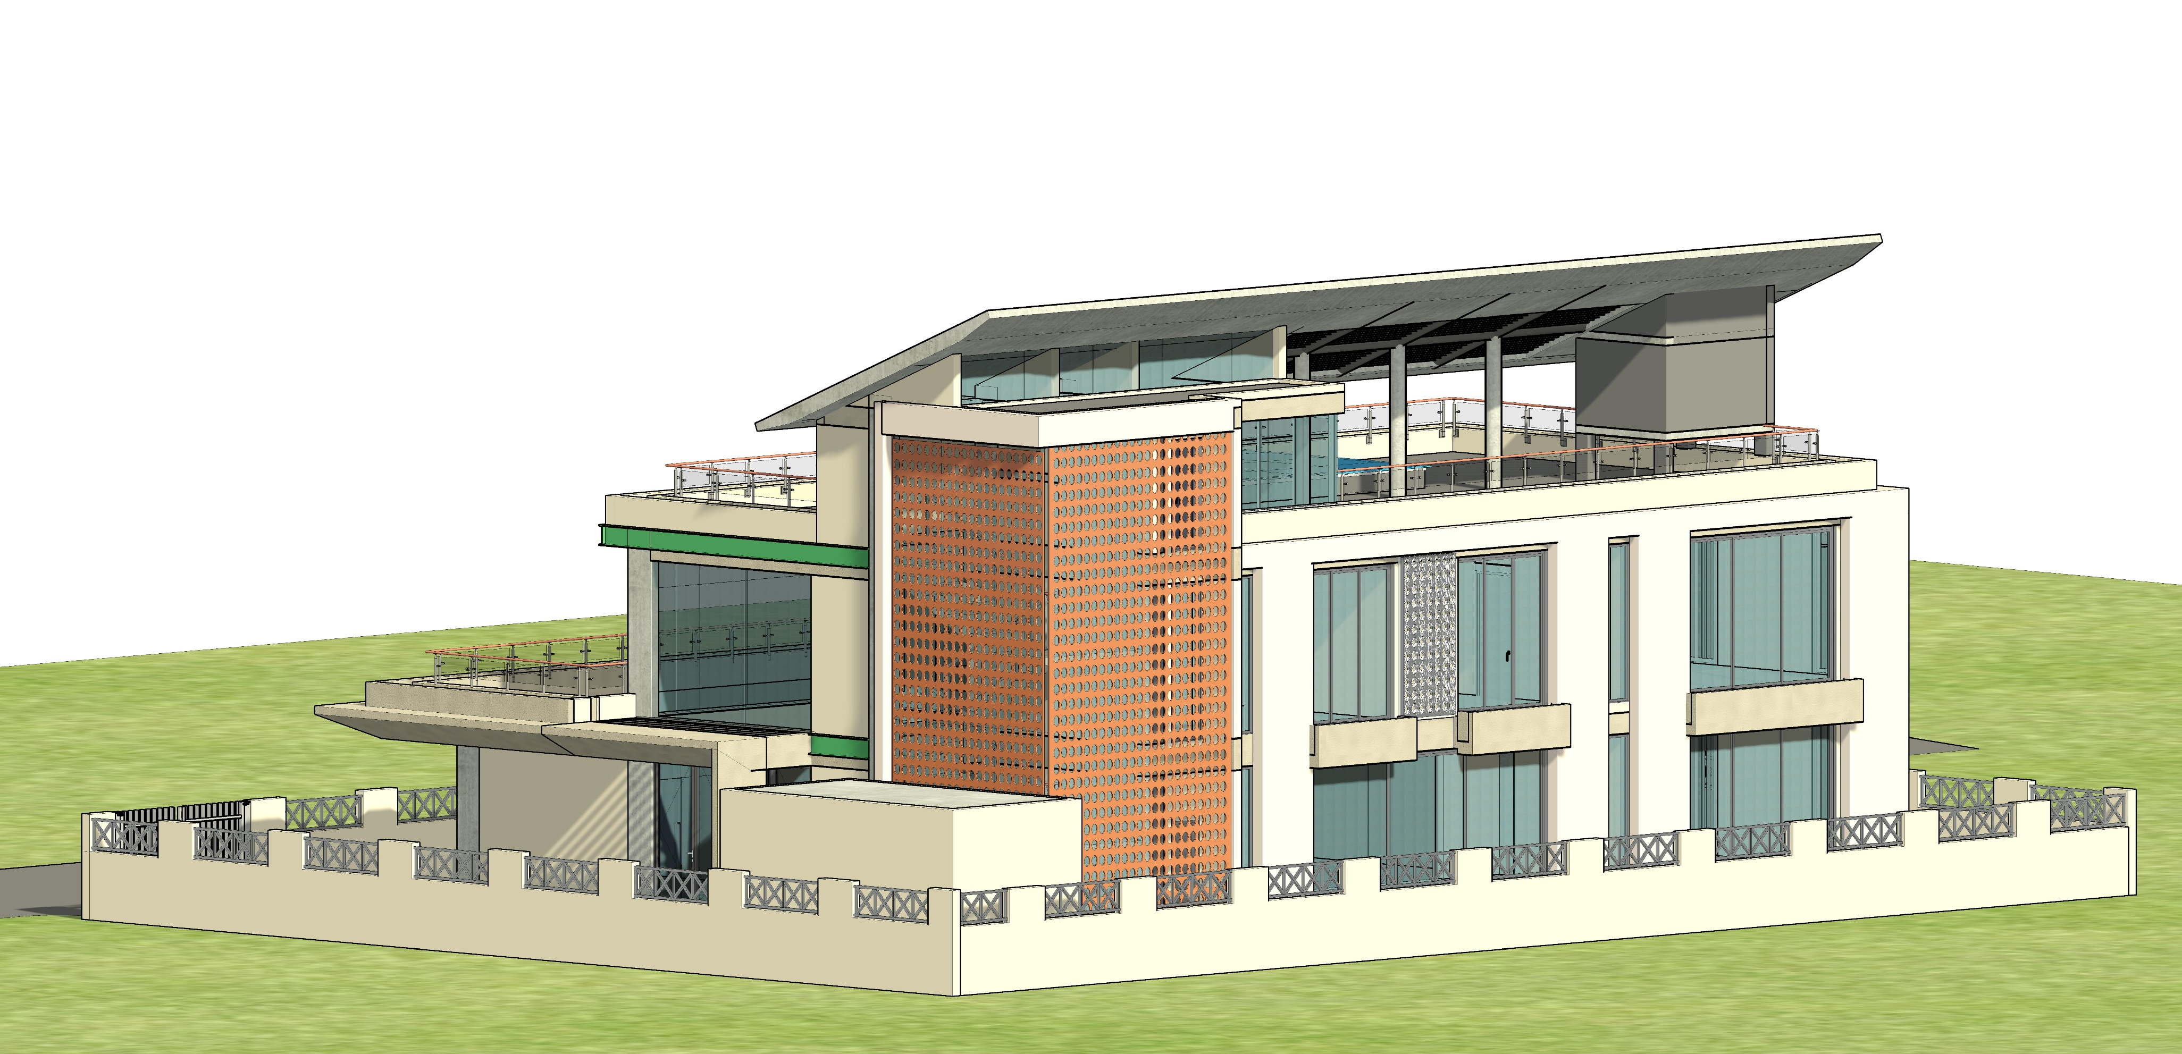
Views
| RESIDENCE OF MRS JYOTI & MR. SHEKHAR REDDY |

Slide 24
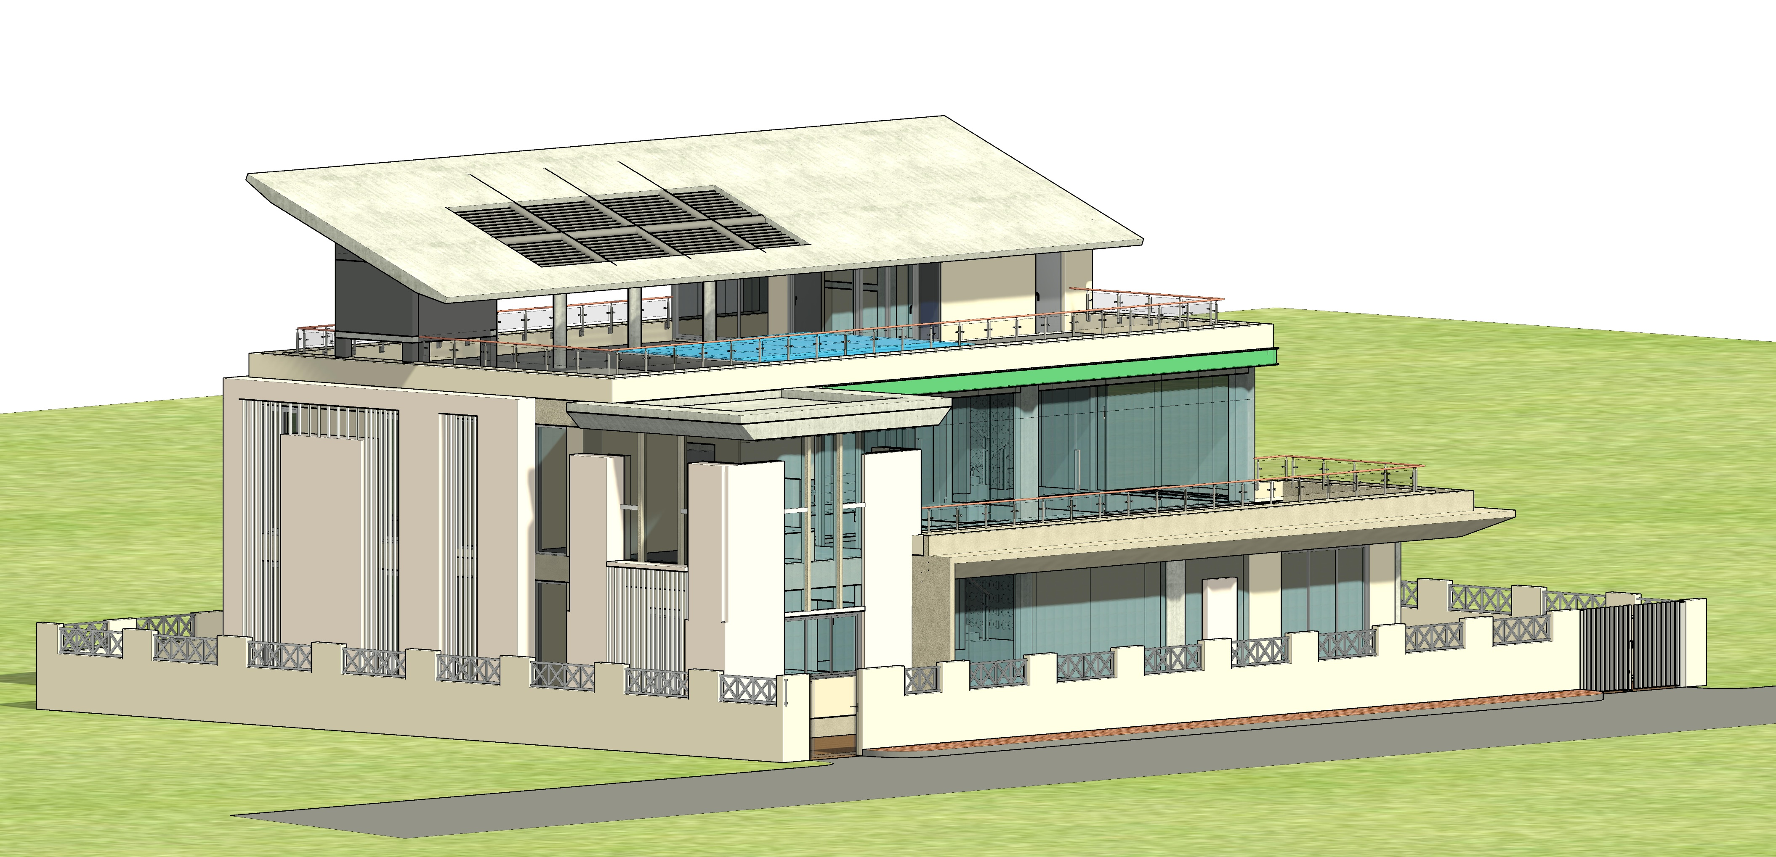
Views
| RESIDENCE OF MRS JYOTI & MR. SHEKHAR REDDY |

Slide 25
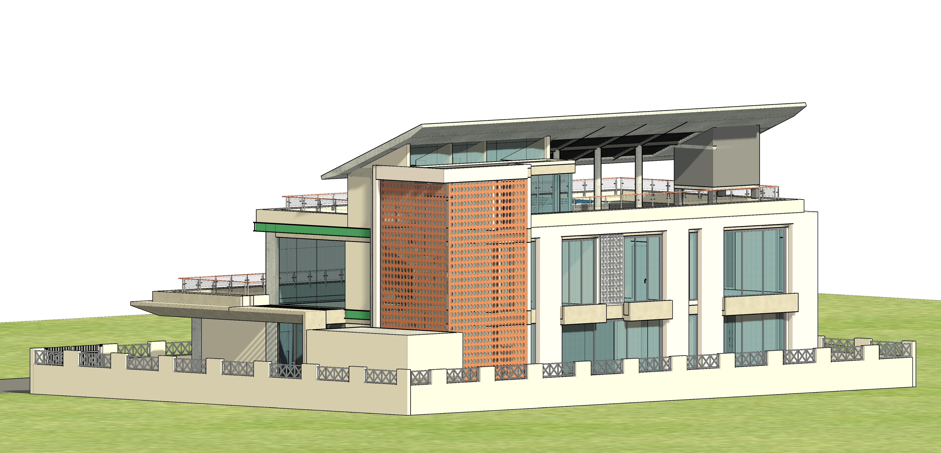
Views
| RESIDENCE OF MRS JYOTI & MR. SHEKHAR REDDY |

Slide 26
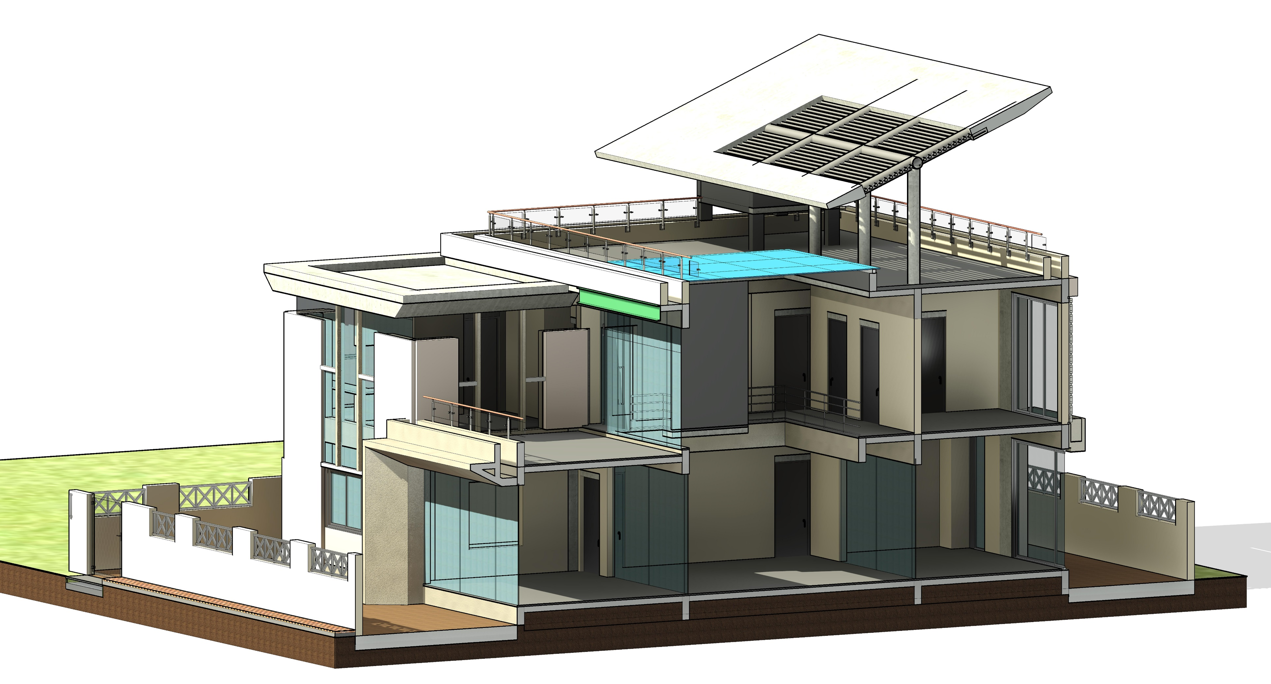
Views
| RESIDENCE OF MRS JYOTI & MR. SHEKHAR REDDY |

Slide 27
THANK YOU

